Slide 1


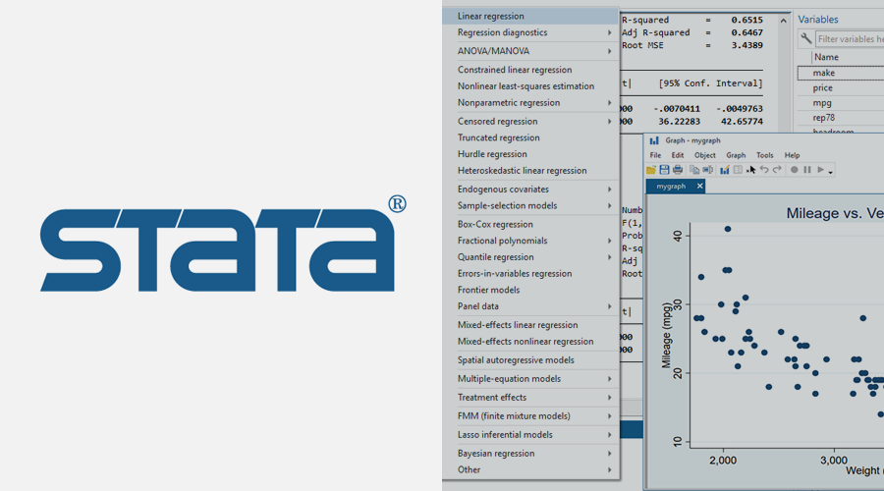
Using a T-test (Student’s T-test) in Excel and STATA
ONE SAMPLE T-test
INDEPENDENT SAMPLES T-test
PAIRED SAMPLE T-test

Slide 2
What is a T-test?
A T-test is used on means between two groups or one group of data collected in testing a hypothesis
The t test tells you how significant the differences between groups are.
In other words it lets you know if those differences (measured in means) could have happened by chance.

Slide 3
Types of T-tests
ONE SAMPLE T-test
A One sample t-test tests the mean of a single group against a known mean.
Here data is collected on one group of individuals and compared to hypothesized mean
For e.g. We would like to test a hypothesis that the mean weight of boys at 25 years is equal to 75kgs.

Slide 4
2. INDEPENDENT SAMPLES T-test
An Independent Samples t-test compares the means for two independent groups
Here data is collected from two separate groups of individuals to test a hypothesis
e.g. Weight gain from eating chocolate is the same as eating a plate of rice
Ho: There is no difference in mean weight gain
Or. The weight of all 25 year old Male and Female students is the same
Ho: There is no difference in mean weight

Slide 5
3. PAIRED SAMPLE (Dependent) T-test
A Paired sample t-test compares means from the same group at different times (say, one year apart).
Here we collect data on the same group of individuals at two time points
For Example;
Repeating a class does not change the mark score of students
Ho: There is no difference in mean mark score of students in repeating a class

Slide 6
Formulas
What do we need?
Means of each sample
Variance of each sample
Number of individuals in each sample

Slide 7
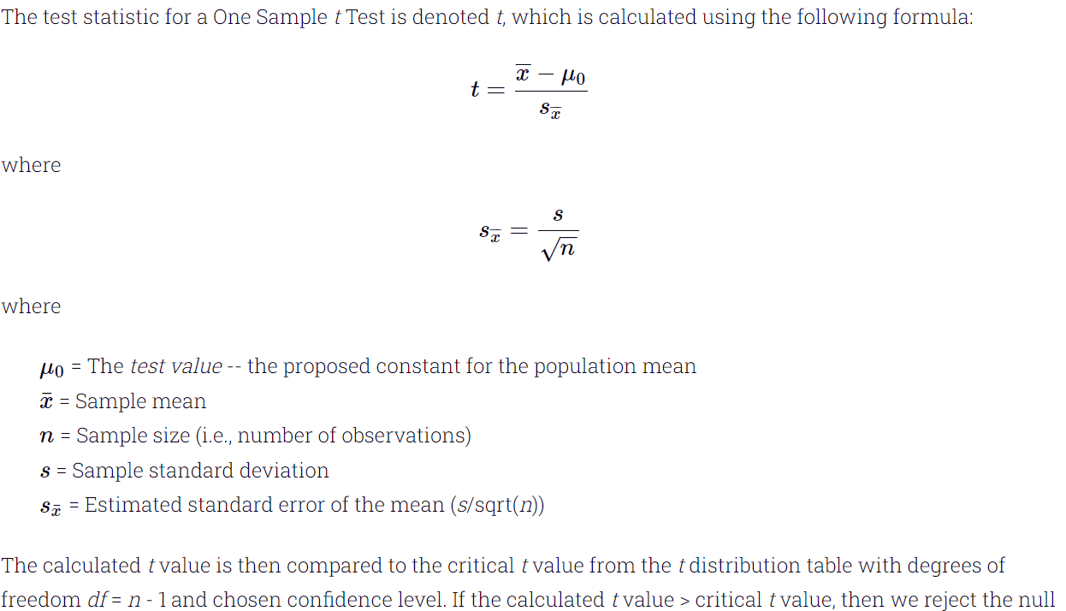
1. One sample T-test

Slide 8
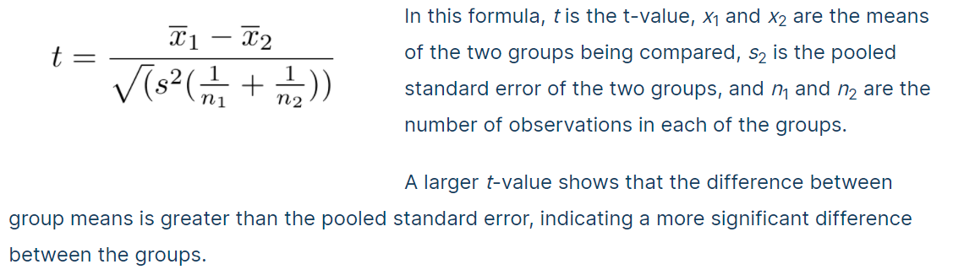
2. Independent T-test

Slide 9
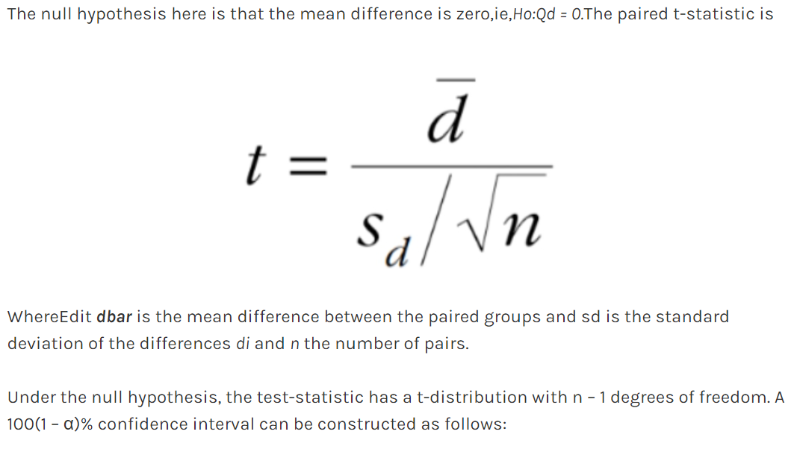
3. Paired T-test

