Slide 1
Principles and Practice of Screening
Bashir Ssuna
MPH -IUIU

Slide 2
Learning objectives
At the end of this session, you will be able to:
Define screening
Describe the purposes of screening.
List criteria for establishing screening program.
Explain the validity of a Screening Test.

Slide 3
Definition
search for unrecognized disease or defect by means of rapidly applied tests, examinations or other procedures in apparently healthy individuals.
‘The presumptive identification of unrecognized disease by application of rapid tests or examinations, or other procedures that can be applied rapidly, in apparently healthy individuals ’

Slide 4
Definition…
A screening test is not intended to be diagnostic.
Screening is an initial examination only, and positive responders require a second, diagnostic examination
Early detection of disease (earlier than would usually occur in clinical practice) in the hope of modifying prognosis

Slide 5
When should we do screening?

Slide 6
Natural course: stages of progression
usual time
of diagnosis
Pathologic
change
Onset of
symptoms
Exposure
Stage of recovery,
disability or
death
Stage of
susceptibility
Stage of
Subclinical
disease
Stage of clinical
disease

Slide 7
Screening should be done;
After sub-clinical disease (changes have occurred), but before symptoms manifest.

Slide 8
Aims of screening
To reverse, halt, or slow the progression of disease more effectively than would probably normally happen
To alter the natural course of disease for a better outcome for individuals affected.
To reduce morbidity & mortality through early detection & treatment (prevention)

Slide 9
Aims cont…
Protect society from contagious disease
Rational allocation of resources
Selection of healthy individuals:
employment, military…
Research; study on natural history of disease…

Slide 10
How do we select diseases for screening program?

Slide 11
Objectives of screening
Early Detection: Identify diseases in asymptomatic individuals to initiate timely intervention and improve health outcomes.
Reduction of Morbidity and Mortality: Decrease disease-related complications and deaths through early treatment.
Prevention of Disease Spread: Control communicable diseases by identifying and managing cases early.
Cost-Effectiveness: Implement preventive measures that are more economical than treating advanced diseases

Slide 12
Types of screening
Mass Screening:
Definition: Testing entire populations or subgroups, regardless of individual risk factors.
Example: Newborn screening for metabolic disorders.
Advantages: Can detect diseases in individuals without known risk factors.
Disadvantages: Resource-intensive; may yield low positive results in low-prevalence populations.

Slide 13
Selective Screening:
Definition: Targeted testing of individuals at higher risk for specific diseases.
Example: Screening individuals with a family history of certain cancers.
Advantages: More efficient use of resources; higher yield of true positive cases.
Disadvantages: May miss cases in individuals without identified risk factors.

Slide 14
Multiphasic Screening:
Definition: Conducting multiple tests during a single screening session to detect various diseases.
Example: Health fairs offering blood pressure checks, cholesterol tests, and glucose measurements.
Advantages: Comprehensive health assessment; convenient for participants.
Disadvantages: Increased chance of false positives; may require more follow-up testing.

Slide 15
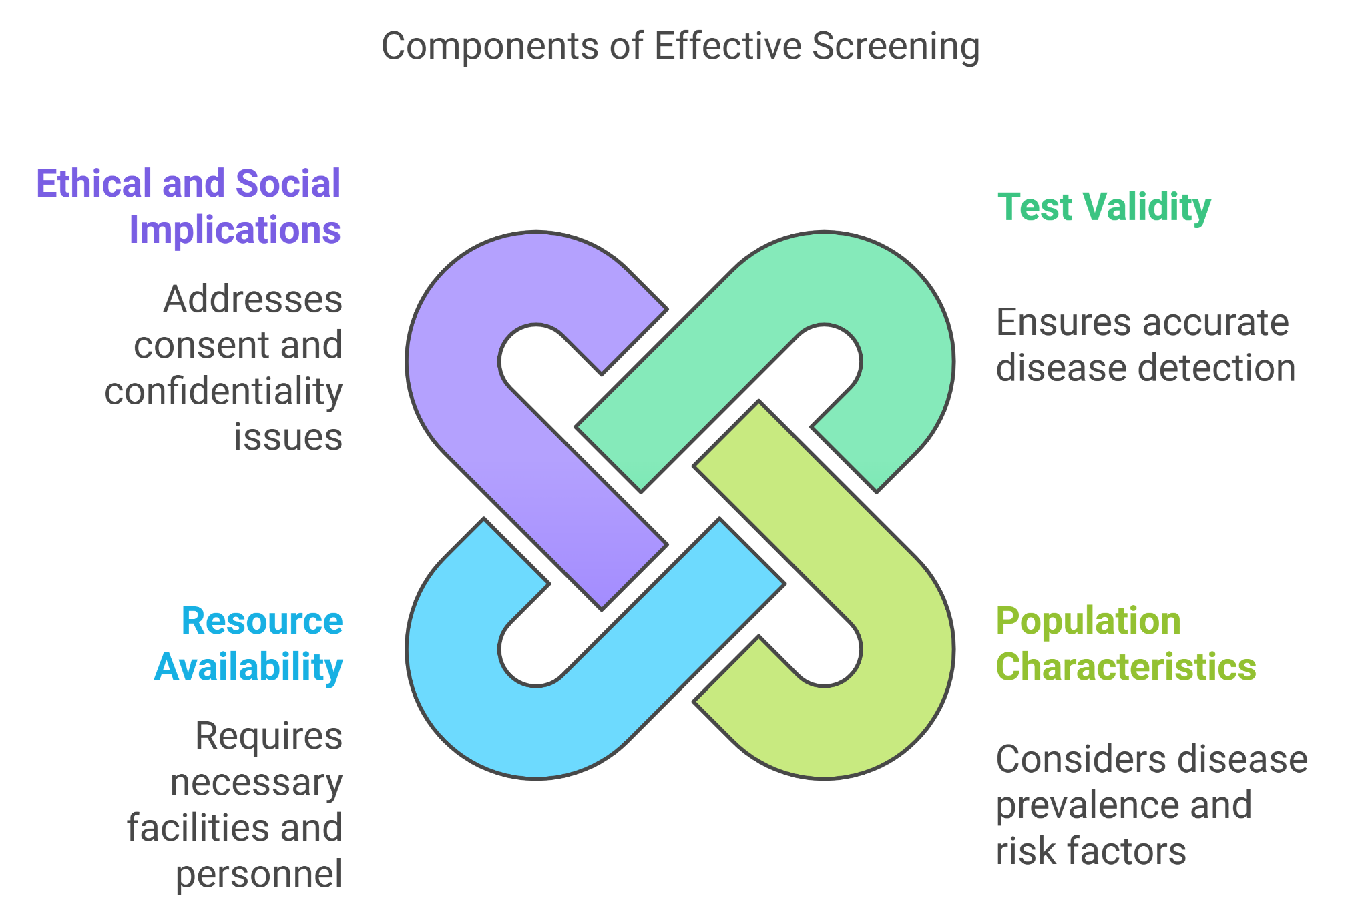

Slide 16
Diseases Appropriate for Screening
To be appropriate for screening:
A disease should be serious
Treatment given before symptoms develop should be more beneficial in terms of reducing morbidity or mortality than that given after they develop
The prevalence of preclinical disease should be high among the population screened

Slide 17
Criteria for establishing screening program
1. The condition sought should be an important health problem.
2. Screening should be undertaken only when it has the potential to lead to a significant decrease in rates of disability, death or both.
3. There should be an accepted treatment for patients with recognized disease

Slide 18
Criteria…
4) Facilities for diagnosis and treatment should be available
5) There should be a recognized latent or early symptomatic stage
6) There should be a suitable test or examination which has high validity as measured by its sensitivity and specificity
7) The test should be acceptable to the population

Slide 19
Criteria…
8) The natural history of the condition should be adequately understood
9) The cost of case-finding (including diagnosis and treatment of patients diagnosed) should be economically balanced in relation to possible expenditure on medical care as a whole.
10) Case finding should be a continuous process and not a “once and for all” project

Slide 20
Criteria for instituting a screening program (Summary)
Disease -Serious
-High prevalence of preclinical stage
-Natural history understood
-Long incubation period
Screening test -sensitive and specific
-Simple and cheap
-safe and acceptable
-Reliable
Diagnostic and -Facilities are adequate
treatment -Effective, acceptable, and safe treatment available

Slide 21
Screening Tests
A screening test should ideally be inexpensive, easy to administer, and impose minimal discomfort on the patients.
results of the screening test must be valid and reliable.

Slide 22
Validity of a Screening Test
Validity of a test is the ability to differentiate accurately between those who have the disease and those who do not.
Sensitivity and Specificity are two measures of the validity of a screening test.
Sensitivity and specificity can also be taken as measures of validity for other tests which are applied for diagnostic purposes.

Slide 23
Outcomes of a Screening Test
 |  | True Disease Status
Screening Test | Positive |  | Negative | Total
Positive | True Positives (TP) |  | False Positives (FP) | TP+FP
Negative | False Negatives (FN) |  | True Negatives (TN) | FN+TN
Total |  | TP+FN | FP+TN | TP+FP+FN+TN

Slide 24
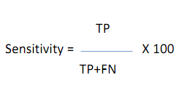
Sensitivity
the ability of a test to correctly identify those who have the disease
the percentage of those who have the disease and are proven to have the disease as demonstrated by a test
is the probability of a positive test in people with the disease

Slide 25

Specificity
the ability of a test to correctly identify those who do not have the disease
the probability of a negative test in people without the disease

Slide 26
Example
Disease status (Gold standard)
Diseased
Not Diseased
Total
Positive 18 49 67
Negative 2 931 933
Total 20 980 1000
Sensitivity = ____Specificity = _____
Screening test results

Slide 27
Predictive Value
The probability that a person tested positive or negative will or will not have a disease.
Depends on…
– Sensitivity
– Specificity
– Prevalence of the underlying condition in the population to whom the test is applied
Positive predictive value
Negative predictive value

Slide 28
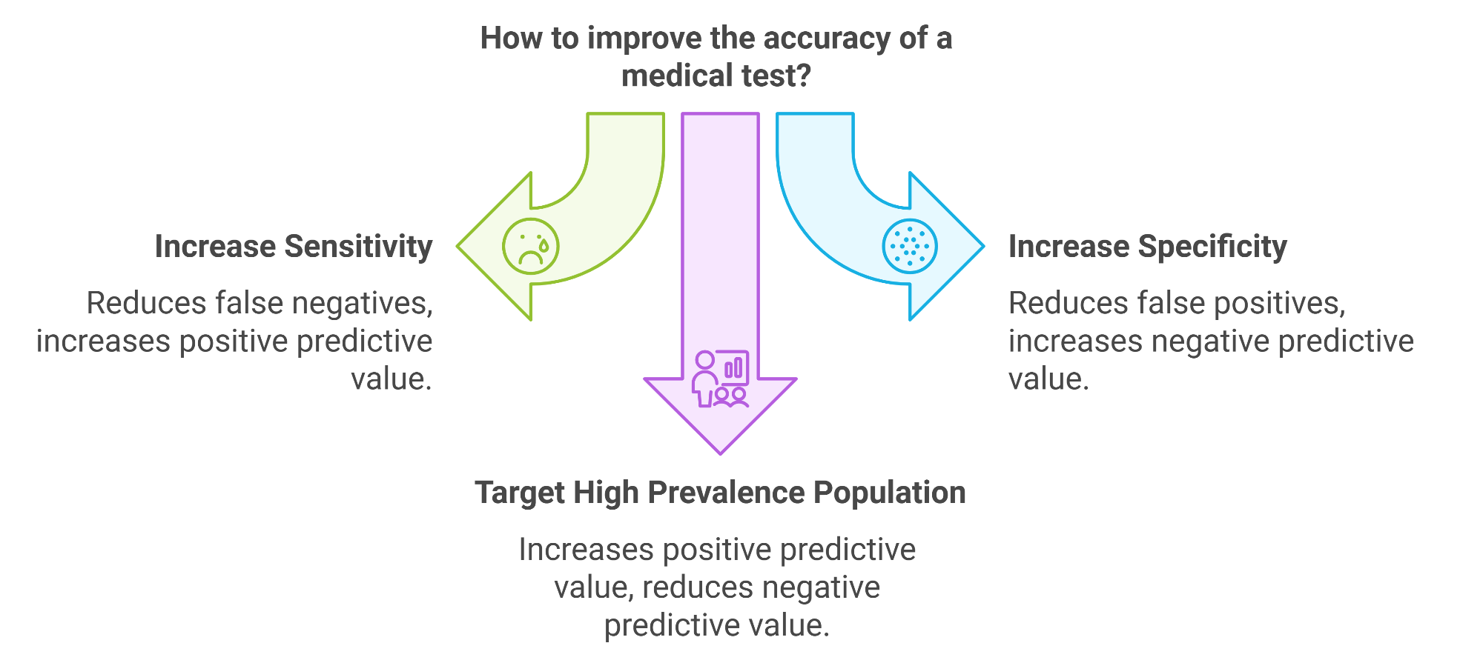

Slide 29

Positive Predictive Value of a Screening Test
is the probability of the presence of the disease in a person with a positive(abnormal) test result.
proportion of screening test positives who are truly positive.
+PV = a/(a+b)

Slide 30

Negative Predictive Value of a Screening Test
Negative predictive value is the probability of not having the disease when the test result is negative (normal).
Shows the degree of confidence the disease can be ruled out by using this specific test.
proportion of screening test negatives who are truly negative
)

Slide 31
The ability to predict the presence or absence of diseases from test results depends on :
prevalence of the preclinical disease in the population
sensitivity and specificity of the test.

Slide 32
The higher the prevalence, the more likely it is that a positive test is predictive of the diseases i.e PVPT will be high.
The more sensitive a test, the less likely it is that an individual with a negative test will have the disease, and thus the greater the predictive value negative.

Slide 33
• The more specific the test, the less likely an
individual with a positive test will be free from the disease ( FP) and the greater the predictive value positive.
• For rare disease, however, the major determinant of the predictive value positive is the prevalence of the preclinical disease in the screened population.

Slide 34
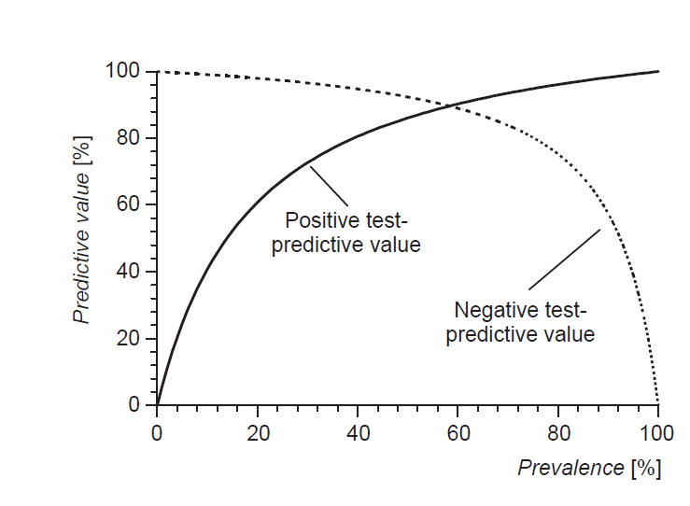

Slide 35

In summary
Sensitivity = probability of testing + when you are HIV+
Specificity = probability of testing - when you are HIV-
Positive predictive value = probability of being HIV+ when you test +
Negative predictive value = probability of being HIV- when you test -

Slide 36
Which test to choose?
Sensitivity
Specificity
Disease is serious and definitive treatment exists
Disease is highly communicable
Subsequent evaluation of positives is not costly and has minimal risk
High risk with further diagnostic techniques
High cost with further diagnostic techniques
No definitive treatment exists

Slide 37
Yield
The proportion of disease identified by the screening test.
The yield of a test result is affected by:
Specificity of the test
Prevalence of the disease
Persons with the disease
Yield = detected by the test X 100 =
Total screened
TP
TP + FN + TN + FP

Slide 38

Example
Five hundred patients known to have a particular disease were screened with a new test. Five hundred controls without this disease were also screened. Of the 500 patients 473 had a positive test. Of the healthy group without the disease seven had a positive test. Create a 2 by 2 table and reflect on the interpretation of the data.
Calculate and interpret sensitivity, specificity, PVP and PVN of the test.

Slide 39
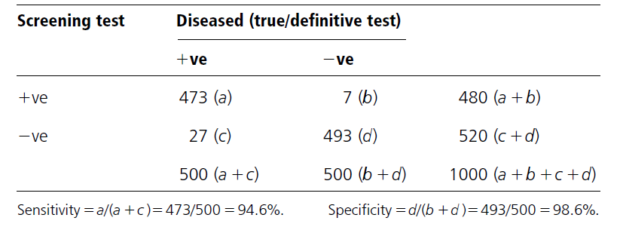
The test will correctly identify most people who have the disease , and also correctly identify most people who are disease free .
PVP test is 473/480=98.5%; the probability that a person who tested positive on the screen actually had the case is 98.5%.
PVN test is 493/520=94.8%, the probability that a person who tested negative truly did not have the case is 94.8%.

Slide 40
Exercise
A new serological test has been developed for diagnosis of bovine tuberculosis. This test was used on 1000 dairy cattle known to be infected with bovine tuberculosis , and 850 dairy cattle which were free of disease. Among the 1000 dairy cattle known to be infected with bovine tuberculosis, 280 had a positive test. Among the 850 dairy cattle designated free of disease, 300 had a negative test.
Construct 2 by 2 table
Calculate and interpret the sensitivity, specificity, PPV, NPV, yield of the screening test, and Prevalence of the disease.

Slide 41
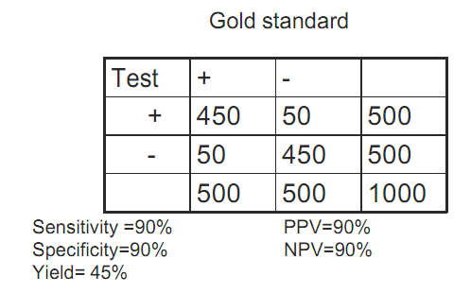
Effect of sensitivity, specificity and prevalence on yield

Slide 42
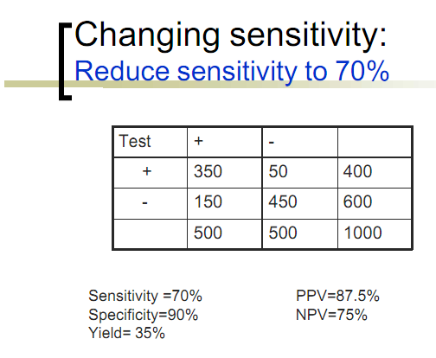

Slide 43
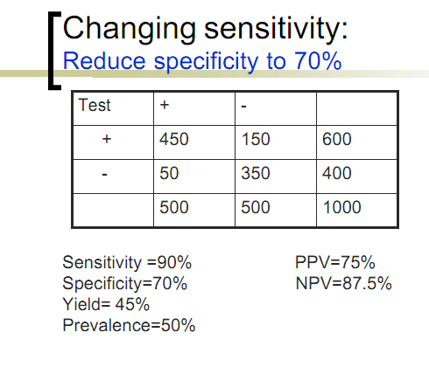

Slide 44
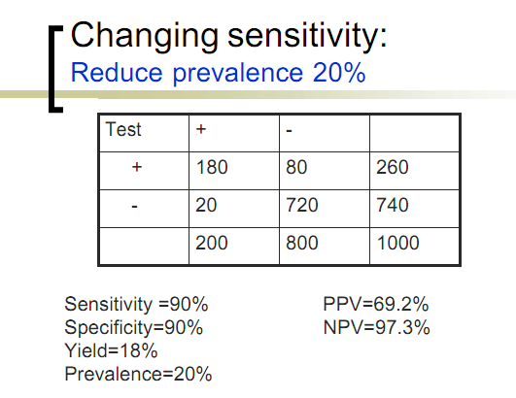

Slide 45

Thank you!!!

