Slide 1


Qualitative Research
In DEPTH
Bashir Ssuna, MD, MCEB, ImS

Slide 2
Introduction
Goal: To enhance the capacity to conceptualize, design and conduct qualitative research
Overview
What is qualitative research?
Types of qualitative research?
Developing a qualitative research question
Qualitative methods and Analysis plan

Slide 3

Overview
Not everything that can be counted counts
and not everything that counts can be counted
~Albert. Einstein

Slide 4



Qn1. What proportion of patients stop taking their diabetes medicine for 3 consecutive days three months after diagnosis?
Qn2. How does medication shape the lives of people with Diabetes?

Slide 5
What is qualitative research?
A strategy for systematic collection, organization and interpretation of textual information
Uses inductive approaches to generate novel insights into phenomena that are difficult to measure quantitatively
understand how people feel and why they feel the way they do. i.e. emotions, feelings, perceptions, experiences

Slide 6
Qualitative Research
Advantages | Disadvantages
Detailed | Less generalizable
Captures narratives and perspectives of participants | ’Subjective’
Contextualizes knowledge | (Usually) studies a smaller number of people
Not based on pre-existing ideas of the researcher
Compelling

Slide 7
Types of qualitative research
Ethnography
- is a long term investigation of a group that is based on optimally participation in that group.
Ethnography provides a detailed exploration of group activity and may include literature about and/or by the group.
Ethnomethodology
is the empirical study of methods that individuals use to give sense to and...to accomplish their daily actions: communicating, making decisions, and reasoning"
Grounded theory
- researchers are responsible for developing other theories that emerge from observing a group. The theories are "grounded" in the group's observable experiences, but researchers add their own insight into why those experiences exist

Slide 8
Phenomenology
seeks to explain the "structure and essence of the experiences" of a group of people. Used mainly by psychologists
A phenomenologist is concerned with understanding certain group behaviors from that group's point of view
Kinesics –
-analysis examines what is communicated through body movement. assumes that all human beings, although they may be unaware of it, act and react to situations nonverbally as well as verbally.

Slide 9
All these methods can characterize participant perspectives and experiences in great depth
Qualitative
Quantitative
MIXED
Approach: Inductive
Goal: Depth of understanding, generate a hypothesis
Setting: Natural
Sampling: Purposeful
Data collection: Interviews, observation tools
Analysis: Iterative interpretation
Approach: Deductive
Goal: Breadth of understanding, tests a hypothesis
Setting: Experimental, Quasi
Sampling: Random
Data collection: Surveys, clinical data
Analysis: Statistical tests, Modeling

Slide 10

Qualitative Techniques
Focus Group Discussions
- Group Composition
- Moderator
- Sitting arrangement
- Venue
- Recording the Discussion
- Motivating Participants

Slide 11
In-depth Interviews
- in-depth interviews explore the what people think, feel, and experience
Types of In-depth Interviews
Ethnography -In ethnographic interviews, respondents are encouraged to provide detailed explanations of their experiences, feeling, and beliefs
Cognitive Testing -Cognitive testing is a structured interview that probes for people’s understanding of certain concepts and terms.
Executive Interviewing -Executive interviewing is a specialized form of in-depth interviewing. It focuses on busy, hard-to-reach professionals and officials

Slide 12
Participant Observation
Aim to gain a close and intimate familiarity with a given group of individuals (such as a religious, occupational, or sub-cultural group, or a particular community)
Their practices through an intensive involvement with people in their natural environment, often though not always over an extended period of time

Slide 13
Observes phenomenon in its natural context
Five Dimensions of Part. Observer
- Role of Observer
- Portrayal of Role of Others
- Portrayal of Study Purpose
    - Duration of Observation
    - Focus of Observations

Slide 14
Recording Observation Data
Mental Notes
Jotted Notes
Expanded Field Notes
Qualities of a Participant Observer
Self Criticism
Good Listener
Objectivity

Slide 15
Narrative Inquiry
Is the process of gathering information for the purpose of research through story telling
The researcher then writes a narrative of the experience – humans are story telling organisms , Connelly and Clandinin (1990)
The study of narratives is the study of ways humans experience the world – Lived and Non – Lived experiences
Relevant in many social sciences /used in many other fields i.e medicine, biological sciences, e.t.c

Slide 16
What does sampling mean in qualitative research?
This differs from some of the understandings held by researchers and scholars in the qualitative research domain
Sampling in qualitative research in its broadest sense can be defined as the selection of specific data sources from which data are collected to address the research objectives and or questions (Gentles et al 2015)

Slide 17
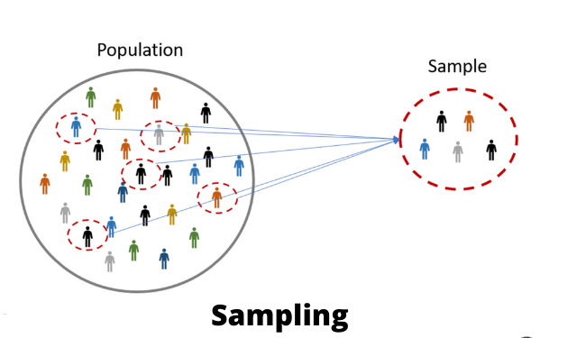
Sampling techniques

Slide 18
Sampling in qualitative research
Phenomenology: Sampling is “choosing informants” (Cohen et al., 2000, p. 45)—it is people that are sampled in this case
Case study: Sampling applies to selecting cases and selecting of data sources “ that best help us understand the case” (Stake, 1995, p. 56)
Thus, what is sampled occurs at two levels, the case and unspecified data sources within the case.

Slide 19
Purposive Sampling
Patton (2015) provides the following description of purposeful sampling:
“The logic and power of purposeful sampling lie in selecting information-rich cases for in-depth study. Information-rich cases are those from which one can learn a great deal about issues of central importance to the purpose of the inquiry...Studying information-rich cases yields insights and in-depth understanding” (p. 264)

Slide 20
Purposive sampling strategies
Maximal Variation Sampling
Extreme Case Sampling
Typical Sampling
Theory or Concept Sampling
Homogeneous Sampling
Critical Sampling
Opportunistic Sampling
Snowball Sampling
Confirming and Disconfirming Sampling

Slide 21
What are the products of qualitative research?
Recurrent themes or hypothesis
Themes are unifying concepts or statements
Identify and characterize
Patterns of behavior
Group interactions
Individual perceptions
Help to develop a testable hypothesis (identify silent factors, informing predictions about relationships)
Survey instrument measure
Taxonomies
Conceptual models

Slide 22
What is qualitative data analysis ?
QDA is the range of processes and procedures of moving from qualitative data that has been collected into some form of
explanation, understanding or interpretation of the people and situations we are investigating.

Slide 23
Steps in QDA
All qualitative data analysis involves four essential steps:
1. Raw data management- ‘data cleaning’
2. Data reduction, I, II – ‘chunking’, ‘coding’
3. Data interpretation – ‘coding’, ‘clustering’
4. Data representation – ‘telling the story’,
‘making sense of the data for others’

Slide 24
Approaches in qualitative data analysis
Two main approaches to qualitative data analysis
Deductive approach – using your research questions to group the data and then look for similarities and differences. e.g. Implementation Science
Inductive approach – using emergent framework to group the data and then look for relationships e.g. Grounded theory

Slide 25
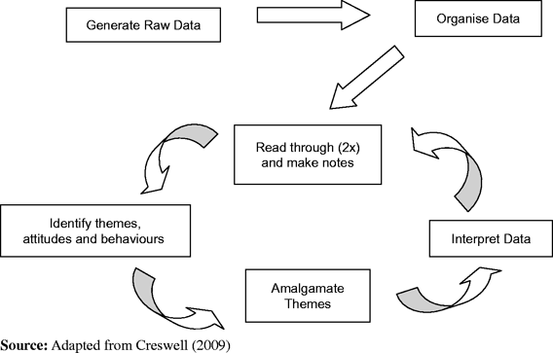
Data Analysis Spiral-1

Slide 26
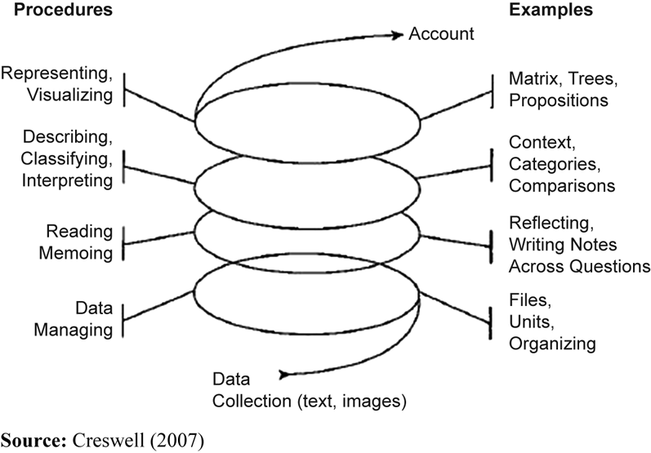

Slide 27
Step 1: Raw Data Management
What is raw data management?
  The process of preparing and organizing raw data into meaningful units of analysis:
    Text or audio data transformed into transcripts
    Image data transformed into videos, photos, charts
    As you review your data, you find that some of it is not usable or relevant to your study

Slide 28
Step II: Data Reduction
Get a sense of the data holistically, read several times (immersion)
Classify and categorize repeatedly, allowing for deeper immersion
Write notes in the margins (memoing)
Preliminary classification schemes emerge, categorize raw data into groupings (chunking)

Slide 29
Annotating Data: the purpose of memos
Memos serve as a written record to document the process of reading and analyzing your data.
• Draw linkages and patterns in your data
across an interview
across participants

Slide 30
Purpose of Memos
• Highlight key and novel findings
• Collect ideas and insights you have into the data
• Note quality of the data available to analyze
• Refine the purpose of the research and analysis in relation to the data

Slide 31
What to capture in memos
Individual quotes- it maybe something interesting in a specific quote that reminds you of something you read in another interview
Memos of individual interviews
Write a summary memo of the interview to capture details of that informant and what they contribute to your understanding of the topic

Slide 32
What to capture in memos
Memos on themes/patterns that emerge
As you start to see patterns in the data, keep track of that through memos to yourself.
Memos on project as a whole
Keep track on your thoughts of the project as a whole. As you read through each of the interviews what are some big picture things you notice across the interviews.

Slide 33
What Memos Do Not Have to Be
Written with perfect grammar
Formatted or structured in any certain way
Understandable to anyone but you and your team

Slide 34
What Do You Do with Memos
If the memo is written before data collection ends, memos can help guide interview questions.
You can develop codes based on themes and content identified in a memo.
You can share memos with your research team to talk through findings and guide direction of the analysis.
Memos can become the structure of the presentation of your findings

Slide 35
Memos
Memos help to keep track of ideas that emerged within each topic.
Memos eventually became the basis
for interpretive codes that are used.

Slide 36
Data Reduction
Develop an initial sense of usable data and the general categories you will create
Develop a preliminary set of codes, cluster raw data into units that share similar meanings or qualities
Create initial code list or master code book

Slide 37
Step II: Data Reduction II
  The process of reducing data from chunks into clusters and codes to make meaning of that data:
  Chunks of data that are similar begin to lead to initial clusters and coding
  Clusters – assigning chunks of similarly labeled data into clusters and assigning preliminary codes
  Codes – refining, developing code books, labeling codes, creating codes through 2-3 cycles

Slide 38
Coding Process
Initial coding may include as many as 30 categories
Reduce codes once, probably twice
Reduce again to refine to codes that are mutually exclusive and include all raw data that was identified as usable

Slide 39
A Priori or In Vivo Codes
A Priori
  Codes derived from literature, theoretical frames
In Vivo (inductive or grounded)
  Codes derived from the data by using code names drawn from participant quotes or interpretation of the data
    “Its like magic” is a phrase that could form the basis for a code category

Slide 40
Coding Levels
Descriptive to Interpretative to Pattern Coding
  Moves from summary to meaning to explanation
OR
Open to Axial to Selective Coding
  Moves from initial theory to developing relationships between codes for emerging theory
OR
First cycle to second cycle coding
  Moving from describing the data units to inferring meaning

Slide 41
Step III:
Data Interpretation & Themes
‘Chunks’ of related data that have similar meaning are coded in several cycles
Once coded, those ‘chunks’ become clustered in similar theme categories
Create meaning for those clusters with labels
Themes emerge from those clusters
Interpret themes to answer research questions

Slide 42
Step IV: Data Representation
Interpretation or analysis of qualitative data occur simultaneously
Researchers interpret the data as they read and re-read the data, categorize and code the data and inductively develop a thematic analysis
Themes become the story or the narrative

Slide 43
Data Representation Types
Telling the story with the data
  Storytelling, Narrative
  Chronological
  Flashback
  Critical Incidents
  Thematic
  Visual representation
  Figures, tables, charts

Slide 44
Qualitative Data Analysis Types
Most common types of analytic approaches:
  Domain/Content
  Thematic
  Grounded theory/Constant comparative
  Ethnographic/cultural
  Metaphorical/ hermeneutical
  Phenomenological
  Biographical/narrative analysis
  Case Study, Mixed Methods, Focus Groups

