Slide 1
Principles of Outbreak Investigation
Dr. Bashir Ssuna

Slide 2
Definitions

Slide 3
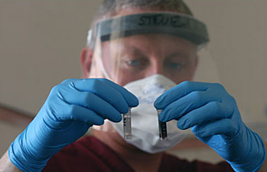
Outbreak:
A disease outbreak is the occurrence of cases of disease in excess of what would normally be expected in a defined community, geographical area or season.
An outbreak may occur in a restricted geographical area, or may extend over several countries. It may last for a few days or weeks, or for several years.
Source - http://www.who.int/topics/disease_outbreaks/en

Slide 4
The criteria for identifying an outbreak.

Slide 5
The occurrence of a greater number of cases or events than normally occurs in the same place and during the same period as in past years.
Or
A cluster of cases of the same disease occurs that can be linked to the same exposure.
Or
A single case of disease that has never occurred before or might have a significant implication for public health policy and practice can be judged as an outbreak that merits investigation.

Slide 6
How can an outbreak be detected?
Health personnel
Laboratories
Official disease notification systems
Newspapers and media
Village health volunteers

Slide 7
Purposes of outbreak investigation

Slide 8
Controlling the current outbreak.
Prevention of future outbreaks.
Research to provide knowledge of the disease.
Evaluation of the effectiveness of prevention programmes.
Evaluation of the effectiveness of the existing surveillance system.
Training of health professionals.
Responding to public, political, and legal concerns.

Slide 9
Components of an investigation team

Slide 10
1.Field epidemiologist
2. Disease control specialists.
3. Laboratory technicians.
4. Specialists in particular areas (e.g. veterinary medicine).
5. Public health administrators.
6. In charge of public relations and press releases.
7. Local health professionals at the district or provincial level

Slide 11
Steps of outbreak investigation

Slide 12
‘Is this a true outbreak?’
Investigators should review the number of cases with the local health officers or hospital staff and compare it with the number found during the same period recorded in past years.
Step 1:
Confirm the existence of an outbreak

Slide 13
If it is confirmed as outbreak then next related question are -
A. What is the correct diagnosis and aetiology of the disease?
B. What can be done immediately to prevent new cases from occurring?
Step 2:
Verify the diagnosis and etiology
of the disease

Slide 14
At this stage, the investigator needs to answer at least three questions:
1. Who should be counted as a case?
2. Are there more undetected cases in the hospitals and in the community?
3. What are the characteristics of cases?
Step 3:
Develop an appropriate case definition, start case finding, and collect
information on cases

Slide 15
Develop an appropriate case definition
It is important that the investigator develop a case definition, which will be applied consistently during the investigation.
The definition should be sensitive or adequate at the beginning, in order to capture actual cases.
A good case definition for investigative purposes should be specific to time and location.

Slide 16
Active case finding
The investigator must start a process called active case finding.
The objective of active case finding is to have enough cases to analyse. At the same time, this case finding will give a better picture of the magnitude of the outbreak.
This active case finding in the community also provides two more benefits:
  Control measures can be implemented if the aetiology of the disease is known and treatable.
  Rapid environmental assessment can be started during the visit to the affected families or villages. From the direct interview with the cases, the investigators can develop hypotheses and implement necessary interventions immediately.

Slide 17
Collecting information on cases
1. Identifying information: name, hospital number, contact person,
and address of contact.
2. Demographic information: age, gender, occupation, religion,
ethnicity, area of residence, place of employment, etc.
3. Clinical information: symptoms and signs, date of onset, duration
of illness, and results of diagnostic procedures.
4. Suspected risk factors: investigators can ask for a history of
exposure to factors before the disease developed.

Slide 18
In this step, investigators need to answer the following questions:
1. What are the main clinical features?
2. What population(s) is at risk?
3. What are the risk factors?
4. What are the most likely explanations of how the outbreak began?
Step 4:
Describe the outbreak in person, place, and time, and hypotheses formation

Slide 19
1. Clinical manifestations of cases
Signs and symptoms of cases can be analysed in percentages and presented in a summary table.
In an outbreak of unknown aetiology, clinical information will help to establish the diagnosis.
For an outbreak in which the aetiology is already known, the investigators still need to compare the clinical information found in the investigation with previous knowledge. Any discrepancy between the investigation and previous knowledge such as the attack rate, mortality rate, severity, and so on should be carefully examined, because this might indicate that a new strain or different specific host response is occurring.

Slide 20
2. Populations at risk
Investigators should analyze the characteristics of cases by gender, age, occupation, ethnicity, and so on. Initially this can be carried out by examining the proportion of all cases, but the specific attack rate by age and gender will be more useful for comparisons and hypothesis formation.
The outbreak of Nipah encephalitis in Malaysia in early 1999

Slide 21
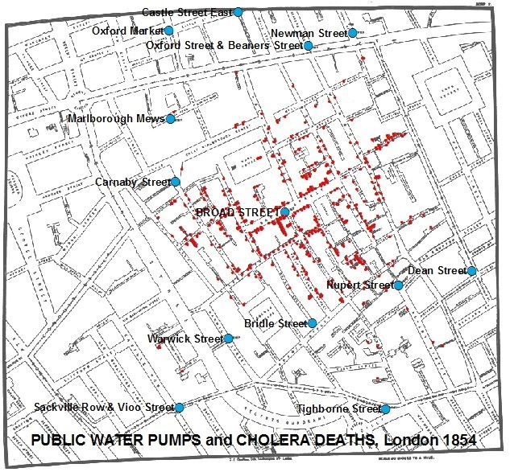
3. Location
Investigators can calculate attack rates of cases in different locations.
These can be places of residence, places of employment, sites of exposure, etc.
Locations with high attack rates often indicate the sources of infection or contamination.
A spot map showing the locations of cases can give a very good idea of the source.

Slide 22
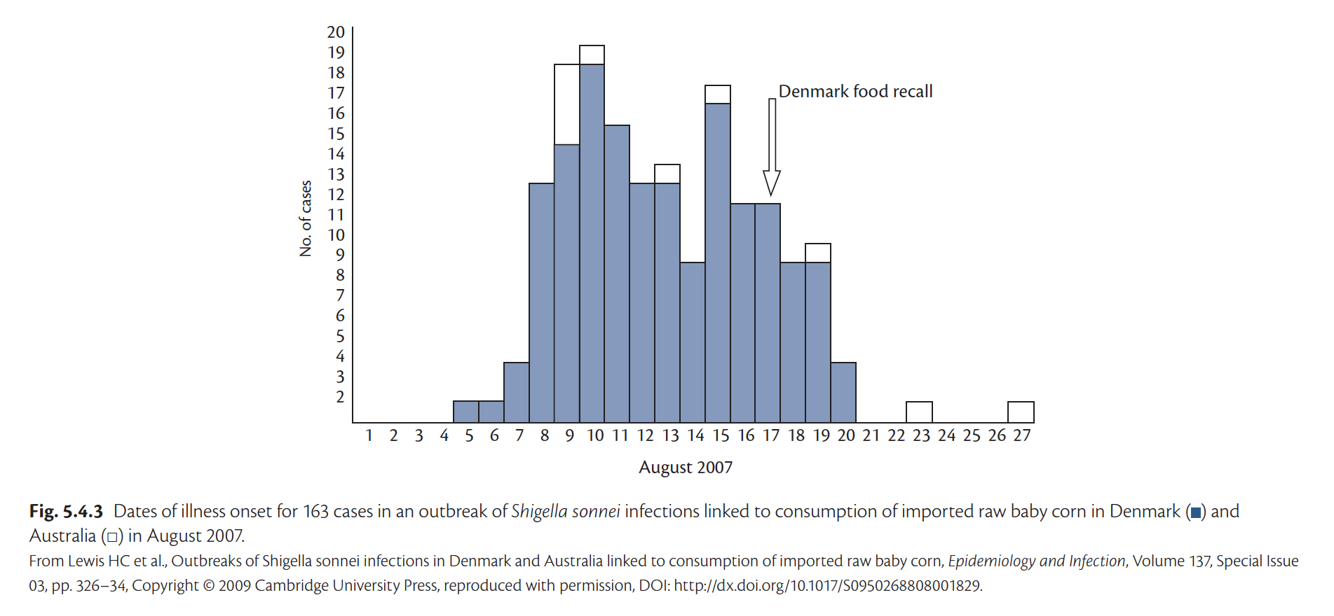
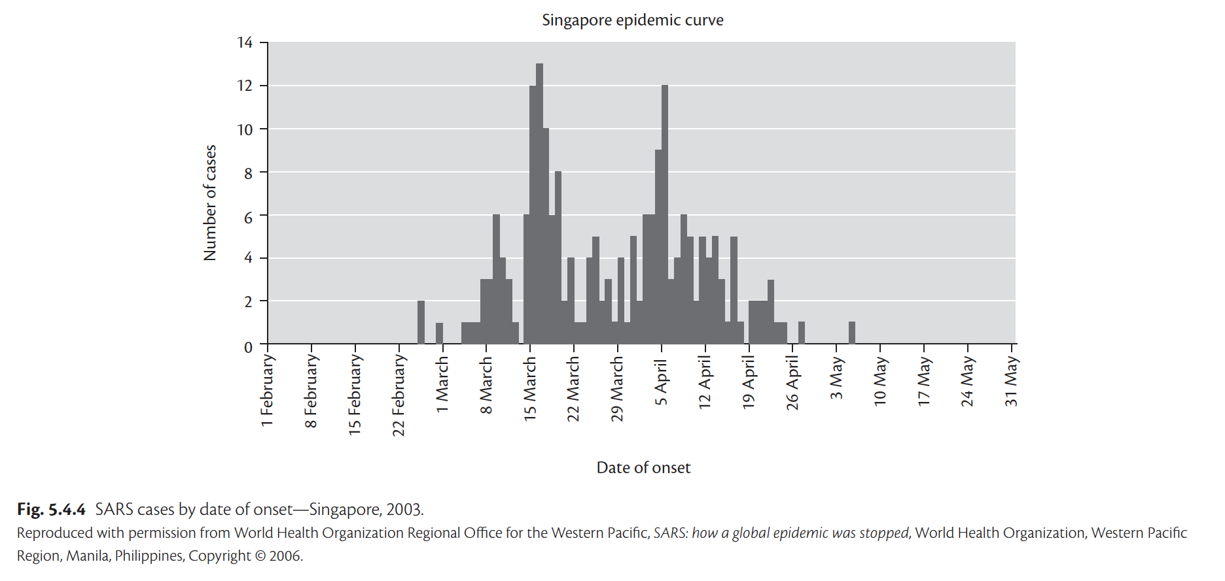
4. Time
The objective is to show the occurrence of cases over time and look for a pattern of occurrence.
In general, there are two major types of outbreaks:
  A common source
  A propagated source.

Slide 23
In an outbreak of infectious disease, the investigator needs to answer the following questions:
1. What is the aetiology of the disease?
2. What is the source of infection?
3. What is the pattern of spread?
4. What are the risk factors for an individual to get the disease?
5. What are the determinants of the outbreak or the factors which, when combined together, result in the outbreak?
A hypothesis needs to be tested by an analytical study design.The most common is a case–control study.
Step 5:
Testing the hypotheses by an analytic study

Slide 24
Example
In May 2011, there is out break of Hemolytic Uremic Syndrome in Germany
After doing first 4 steps of they came to know cases are by Shiga toxin-producing Escherichia coli O104:H4 after taking meal in a buffet.
Similar outbreak also occurred after 1 month again after the buffet
Then there arise a confusion how to pin point which food in buffet caused this outbreak??
Food Item | RR | P Value
Sprout | 4.2 | 0.001
Gazpacho (tomato-based cold soup) | 2.4 | >0.05
Carrots | 2.3 | >0.05
Water (bottled) | 2.0 | >0.05
Dip sauce (mayonnaise) | 1.7 | >0.05
Lettuce | 1.0 | >0.05
Green peppers | 0.4 | >0.05

Slide 25
Although an analytical study might be able to confirm a hypothesis, the investigator still needs to find environmental or other evidence to support and explain the epidemiological evidence.
Step 6:
Environmental or other studies to supplement epidemiological findings

Slide 26
In this steps we have to compile all the evidence to give the complete picture of the outbreaks
What evidence we have
Laboratory evidence:
Clinical evidence:
Environmental evidence
Epidemiological evidence
Step 7:
Establishing the causes of the outbreak

Slide 27
Complete analysis and data interpretation:
Present the main findings with recommendations:
What can be done to control the outbreak?
How to prevent future outbreaks ?
How to improve the investigation ?
How to improve surveillance ?
Step 8:
On-site reporting to and
recommendations for concerned authorities

Slide 28
In addition to on-site reporting, the investigator should disseminate information to educate the public health community and the general public.
The information will raise the awareness of health and government authorities to assess their own situation and implement measures to prevent possible outbreaks.
Dissemination of information should occur in a timely manner through weekly or monthly reports.
Release of important findings through the mass media is also very useful for educating the public
Step 9:
Dissemination of information

Slide 29
Finally, the investigator should follow up the investigation by maintaining close communication with local health authorities.
An absence of new cases for at least two incubation periods of the infectious disease under investigation could suggest that the outbreak is subsiding.
A good investigator should follow up on the recommendations.
Step 10:
Follow-up to ensure implementation
of control measures

Slide 30
To Sum Up
Confirm the existence of Outbreak
Verify diagnosis and determine the etiology
Develop case definition & start case fining
Describe epidemic in time, place and person
Test hypothesis
Carry out necessary environmental epidemiological study
Draw conclusions
Report and recommend appropriate control measures
Communicate the Findings
Follow up the recommendation

Slide 31
The reality….
time
Site visit
Case definition
Recommendations
Report
Publication
Confirmation
Organize Data
Descripitve
Epidemiology
Confirm Diagnosis
Info:
Outbreak
suspected
Line list
Analytic
Epidemiology
Form Outbreak Control Team
Control measures

Slide 32
THE END
THANK YOU

