Slide 1
Epidemiology
Associate Prof Charles Karamagi CHS, Makerere University

Slide 2
Old Definitions of Epidemiology
The study of epidemics
The study of the distribution and determinants of disease frequency
The study of the distribution and determinants of health related states or events in specified populations and the application of this study to the control of health problems (John Last, 1988)

Slide 3
Modern Definition of Epidemiology
Study of the occurrence and distribution of health-related diseases or events in specified populations, including the study of the determinants influencing such states, and the application of this knowledge to control the health problem
(Porta M, Last J, Greenland S. A Dictionary of Epidemiology, 2008)

Slide 4
Descriptive Epidemiology
Distribution of disease in population according to chararacteristics of Person, Place, Time
Analytical Epidemiology
Identification of risk factors and causes for the occurrence of diseases

Slide 5
Objectives of Epidemiology
To identify the aetiology or cause of a disease and the risk factors
To determine the extent of disease found in the community
To study the natural history and prognosis of disease
To evaluate preventive and therapeutic measures and modes of health care delivery
To provide the foundation for developing public health policy

Slide 6
Epidemiology and Prevention
Levels of prevention
  Primary prevention e.g. use of Insecticide Treated Nets
  Secondary prevention e.g. Early treatment of uncomplicated malaria
  Tertiary prevention e.g. physiotherapy in cerebral palsy to avoid contractures
Approaches to prevention
  Population based approach e.g. iodination of salt
  High risk approach e.g. use of SP during pregnancy

Slide 7
Epidemiology
Epidemiology is the basic science of public health and clinical medicine
A highly quantitative discipline that uses biostatistics as an important part of its research methodology
Epidemiology borrows from many disciplines including biology, medicine, statistics, demography, and social sciences

Slide 8
Scope of Epidemiology
Initially, study and control of epidemics
Now, much broader in scope
  Illness centered
    Cardiovascular epidemiology
    Cancer epidemiology
    Infections disease epidemiology
    Respiratory disease epidemiology
    Perinatal epidemiology
  Determinant centered
    Nutritional epidemiology
    Occupational epidemiology
    Behavioral epidemiology
  Clinical epidemiology
    Study of disease outcome
    Clinical trials
  Studies of quality of health care

Slide 9
History of Epidemiology
Hippocrates
  On airs and waters 460BC
John Grant
  Mortality analyses 1662
James Lind
  Scurvy 1753
Edward Jenner
  Smallpox 1768

Slide 10
History of Epidemiology
William Farr
  Registration of deaths 1840
Ignaz Semmelweis
  Puerperal sepsis 1850
John Snow
  Cholera 1853
Bradford Hill/Richard Doll
  Smoking vs CHD/Lung Cancer 1950

Slide 11
Lessons from History of Epidemiology
1. Description of disease distribution (descriptive epidemiology), and
2. Analyses of relationships between possible causal factors and disease occurrence (analytic epidemiology)
may lead to hypotheses that can be tested by
3. Study of disease occurrence after removal of possible causal factors (intervention studies)
Diseases can be prevented without complete knowledge of specific causal factors (e.g.Vibrio cholerae was discovered by Robert Koch in 1883)

Slide 12
The Epidemiologic Approach
Observation of a disease
Formulation of questions as regards the aetiology of the disease
Hypothesis generation as to the possible aetiological factors
Experimentation, analysis and comparison
Conclusions
Application

Slide 13
Epidemiological Study Designs
Experimental
Observational studies
  Cohort studies
  Case control studies
  Cross sectional studies
  Ecological studies
  Case series
  Case reports

Slide 14
Analytic epidemiologic study designs
Cross-sectional
  Exposure & disease measured at one point in time
Case-control
  In subjects with (cases) & without disease (controls), exposure assessed retrospectively
Cohort
  Subjects without but at risk of disease classified as exposed or unexposed, follow up for disease occurrence
Intervention trial (=experiment)
  Subjects allocated to intervention or control, follow up for disease occurrence or recovery
14
Notes:
14
Counterfactual ideal!
Observational studies (e.g. less fat->CVD reduction, alcohol increases risk of MI): Lots of background noise. Often difficult to ascribe effect to exposure, i.e. to distinguish between the effect of the exposure (e.g. exercise) and factors that are associated with the exposure (e.g. people who drink less smoke less).
RCTs:
A. Blinding (masking) reduces chance of noise (bias) introduced by knowledge of exposure status (cohort studies) or of disease status (CC studies)
B. Randomization reduces chance of selection bias. BUT especially small RCTs: Randomization very often results in differences at baseline!§!!
C. foundation for (understanding) lab experiments.
D. Basis for understanding observational studies because we in observational studies actually try to “mimic” the situation in randomized trials.
People do trials to fill their cvs. 1 good study much better than 8 bad studies, which tend to yield confusion, controversy and political battle.

Slide 15
Cross-sectional design
THE PRESENT
Exposed & diseased
Exposed & not diseased
Unexposed & diseased
Unexposed & not diseased
Participant population
Inclusion & exclusion criteria
Study Population
15
Notes:
15
Association: Exp&Dis↑ and Unexp&not dis↑
Main problem: Chicken-and-egg, which comes first?:
Severe measles and malnutrition:
Clinicians know that kids with severe measles are substantially more malnourished than kids with non-severe measles. A cross-sectional study in a community hospital finds that the proportion of kids with severe measles is twice as high among the malnourished than among the well-nourished kids. Severe measles may CAUSE nutritional insult, so maybe we’re just measuring the impact of measles on nutritional status!

Slide 16
Case-control design
THE PAST
THE PRESENT
No exposure
Disease present
Exposure
Cases
Disease absent
Exposure
No exposure
Controls
Hypothetical study cohort
Source population
16
Notes:
16
No need to always select all cases or even a representative sample of all cases; you may for ex. choose to select those cases with severe diarrhea, but your study question will then of course be how is the exposure associated not with diarrhea, but with severe diarrhea.

Slide 17
Prospective cohort study design
THE PRESENT
THE FUTURE
No disease
Risk factor present
Disease
Risk factor absent
No disease
Sample
Disease
Population
17
Notes:
17

Slide 18
Randomized controlled trial design
THE PRESENT
THE FUTURE
No disease
Disease
Intervention group
Participant population
Random allocation
Dropouts, rejections
Control group
Inclusion & exclusion criteria
No disease
Study Population
Disease
Reference target population
18
Notes:
18
Some people use the term “Reference target population”: Population from which you derive your patients (subjects). E.g.: of 1000 HIV-exposed infants (=reference target population), i.e. infants of HIV+ mothers, you select the 50 that have HIV-infection (Study population). Or: of 1000 infants with acute diarrhea (Reference target population), you select the 50 that have dysentery (Study population).
The term “control” is used in two ways:
CC studies: Those without disease
Trials: Those without intervention
CONFUSING!

Slide 19
Ecological study
Unit of observation is groups, not individuals
Groups
Households
Families
Communities
Geographical areas
Cohorts
Other….

Slide 20
Ecological variables
Aggregate measures (statistics) e.g. prevalence of an exposure category in the group
Environmental measures summarizing exposures that vary individually e.g. level of air pollution in the area
Environmental measures that are identical for each individual e.g. existence of a specific law or policy in the area

Slide 21
Rationale
Low cost; convenience
  Availability of group-level secondary data from registries, censuses
  Collection of individual-level data can be expensive and time-consuming
Useful to depict trends (geographical, time) in group characteristics
The interest may be in ecological determinants of morbidity and mortality rather than in determinants of illness and death in individuals

Slide 22
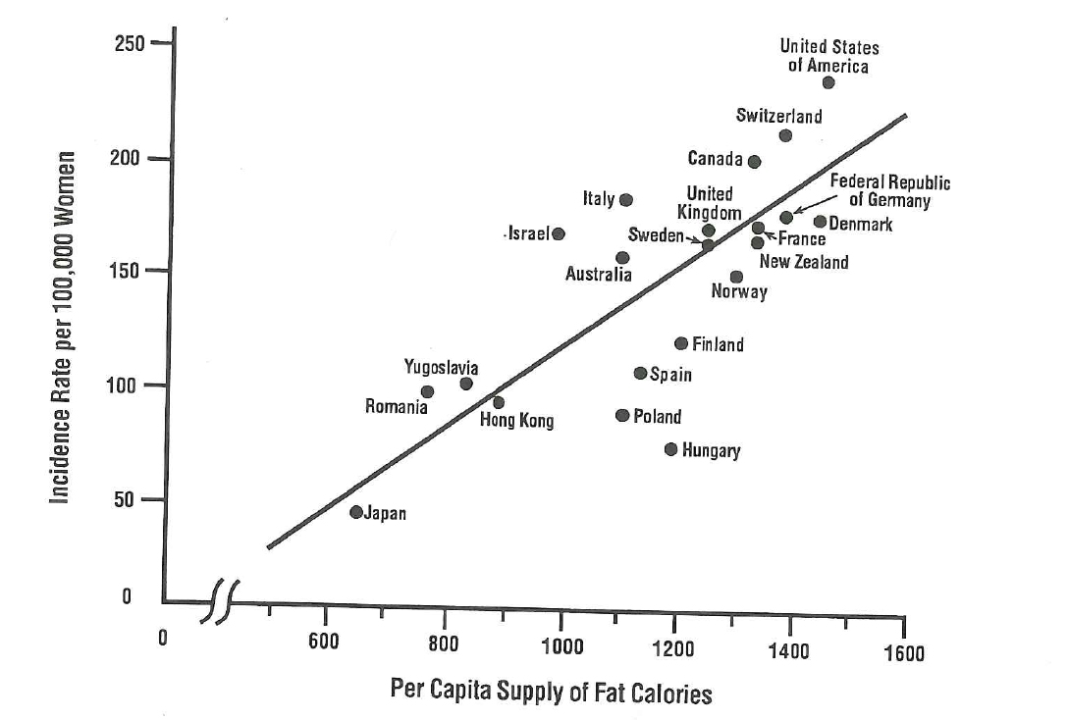
Correlation between dietary fat intake and breast cancer by country
From: Prentice et al., 1988; in: Gordis, L. 2009. Epidemiology- 4th edition; page 229.

Slide 23
Ecologic studies
Is causal inference possible ?
Yes, but the inference is about group-level phenomena, not about processes in individuals
Ecologic data can suggest further etiologic research on individual-level factors but can rarely demonstrate causality at that level
Drawing wrong etiologic conclusions from ecologic studies about effects of individual-level factors is called the ecologic fallacy or ecological bias

Slide 24
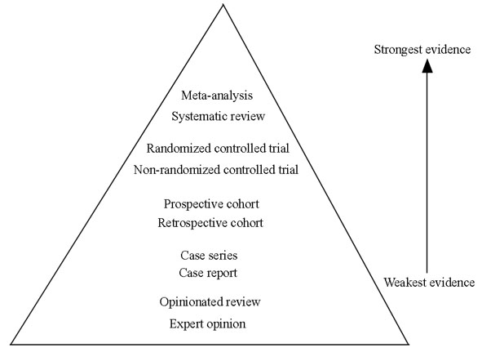
Hierarchy of research evidence
Notes:
There are inherent strengths and weaknesses to each study design. Hierarchy of evidence has been established based on the strengths and limitations inherent to specific study designs. This hierarchy of evidence also indicates a study design's susceptibility to bias and confounding, which are two important concepts in evidence based medicine. Bias is the distortion of study data, whereas confounding is the inability to distinguish the separate impacts of multiple variables on a single outcome

Slide 25
Appropriate study design(s)
Objective | Study Design
Aetiology or risk factors of disease | Cohort, Case-Control
Extent of disease in population | Cross-sectional
Natural history and prognosis of disease | Cohort
Evaluate preventive and therapeutic measures and modes of health care delivery | RCT
Formulate public health policy | All

Slide 26
Infectious Disease Epidemiology

Slide 27
Infectious Disease Epidemiology
- Special Features
Specific issues and concepts
  Transmission routes, incubation times, sources etc
Contact patterns play major role
  who meets whom?
  how often?
  how?
Subclinical infections influence epidemiology
Immunity
A case can also be an exposure (risk factor)

Slide 28
A case is a risk factor …
  Infection in one person can be transmitted to others

Slide 29
Factors Influencing Disease Transmission
Age
Sex
Genotype
Behaviour
Nutritional status
Health status
Host
Agent
Environment
Infectivity
Pathogenicity
Virulence
Immunogenicity
Antigenic stability
Survival
Weather
Housing
Geography
Occupational setting
Air quality
Food

Slide 30
Epidemiologic Triad-Related Concepts
Infectivity – ability to invade a host
  (# infected / # susceptible) X 100
Pathogenicity – ability to cause disease
  (# with clinical disease / # of infected) X 100
Virulence – ability to cause death
  (# of deaths / # with disease (cases)) X 100
All are dependent upon the condition of the host

Slide 31
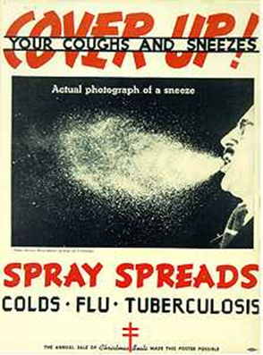
Mode of transmission
  Person-to-person (respiratory, orogenital, skin)
    Examples: HIV, measles
  Vector (animals, insects)
    Examples: rabies, yellow fever
  Common vehicle (food, water)
    Examples: salmonellosis
  Mechanical vectors (personal effects) such as doorknobs, or toothbrushes

Slide 32
Dynamics of Spread through Human Populations
  Spread by a common vehicle
    Ingestion Salmonellosis
    Inhalation Legionellosis
    Inoculation Hepatitis
  Propagation by serial transfer from host to host
    Respiratory Measles
    Anal-oral Shigellosis
    Genital Syphilis

Slide 33
Principle Reservoir of Infection
    Man Infectious hepatitis
    Other vertebrates (zoonoses) Tularemia
    Agent free-living Histoplasmosis
Portal of Entry/Exit in Human Host
    Upper respiratory tract Diphtheria
    Lower respiratory tract Tuberculosis
    Gastrointestinal tract Typhoid fever
    Genitourinary tract Gonorrhea
    Conjunctiva Trachoma
    Percutaneous Leptospirosis
    Percutaneous (bite of arthropod) Yellow fever

Slide 34
Herd Immunity
The resistance of a group to attack by a disease to which a large portion of members are immune, thus lessening the likelihood of a patient with a disease coming into contact with a susceptible individual.
Notes:
The decreased probability that a group will develop an epidemic because the proportion of immune individuals reduces the chance of contact between infected and susceptible persons
The entire population does not have to be immunized to prevent the occurrence of an epidemic
Example: smallpox, measles

Slide 35
Requirements for Herd Immunity
Disease agent restricted to a single host species within which transmission occurs
Relatively direct transmission from one member of the host species to another
Infections must induce solid immunity
Outbreaks occur only in randomly mixing populations

Slide 36
Transmission
Cases
Index – first case identified
Primary – case that brings the infection into a population
Secondary – infected by a primary case
Tertiary – infected by a secondary case
T
S
Susceptible
P
S
Immune
S
T
Sub-clinical
Clinical
Notes:
Index Case
Person that comes to the attention of public health authorities
Primary Case
Person who acquires the disease from an exposure
Attack rate
Secondary Case
Person who acquires the disease from an exposure to the primary case
Secondary attack rate

Slide 37
Endemic: The habitual presence of a disease within a given geographic area; may also refer to the usual prevalence of a given disease within such an area
Epidemic: The occurrence in a community or region of a group of illnesses of similar nature, clearly in excess of normal expectancy, and derived from a common or from a propagated source
Pandemic: A world-wide epidemic
Notes:
American Public Health Association Definitions

Slide 38
Endemic vs Epidemic
Number of Cases of a Disease
Endemic
Epidemic
Time

Slide 39
Factors that determine susceptibility to infection
Genetic
  e.g. Sickle cell anemia
Nutritional
  e.g. malnutrition
Immunological
  Very young children
  immunodeficiency

Slide 40
Factors that determine susceptibility to infection
Host characteristics
  Age, sex, race, education, religion, marital status
Agent
  Biological, chemical, physical, nutritional
Environment
  Temperature, humidity, altitude, crowding, air, water, food,

Slide 41
Body surfaces through which disease is transmitted
Alimentary canal – open tube
Respiratory tract
Urogenital tract
Skin
Eyes and naso-lacrimal duct

Slide 42
Carrier status
Individual harbours the organism but is not infected as measured by serologic studies or by evidence of clinical illness.
May be of limited duration or chronic for months or years
Example of Typhoid Mary – salmonella typhi - New York

Slide 43
Determinants of Disease Outbreaks
Balance between susceptibility and immunity of individuals in population
Immunity may come from previous disease or immunization
Outbreaks occur when a large proportion of the population is susceptible and is exposed to the infection

Slide 44
Incubation period
The interval from receipt of infection to onset of clinical disease
Reflects the time needed for the organism to multiply and reach critical mass; the site of infection; and the dose of organism
Median incubation period for a disease can be determined from data on onset of disease in population

Slide 45
Attack rate
Number of people at risk who develop a certain illness/Total number of people at risk
Same as cumulative incidence
Primary case – acquires disease from source
Secondary case - acquires disease from primary case
Cross tabulation to investigate an outbreak

Slide 46
Outbreak investigation (I)
Ate Did not eat
Item Sick Total % Sick Sick Total % Sick
Chicken 179 264 67.8 22 50 44.0
Fish 176 226 77.9 27 73 37.0

Slide 47
Outbreak investigation (II)
Cross-tabulation
Ate Fish Did Not Eat Fish
Item Sick Total % Sick Sick Total % Sick
Chicken 152 201 75.6 19 72 26.4
No chicken 12 15 80.0 7 28 25.0
N.B.
Compare the attack rates along the rows then the columns.
What was the most likely cause of the outbreak?

Slide 48
Case Fatality Rate
Reflects the fatal outcome (deadliness) of a disease, which is affected by efficacy of treatment
Case fatality rate (%)
=
Number of deaths due to disease
x 100
Number of cases of disease

Slide 49
What is an outbreak?
A public health emergency
A political emergency
An economic emergency
An unusual event
An event requiring rapid action
Surveillance failure
Control failure
An opportunity

Slide 50
What is outbreak management ?
The process of anticipating, preventing, preparing for, detecting, responding and controlling outbreaks in order that the health and economic impact is minimised

Slide 51
Components of Effective Outbreak Management
Anticipation/prediction
    so that epidemics be prevented
Preparedness
    so there is readiness to respond
Early detection
    to know when there is a problem
Rapid Investigation
    to describe the event and identify interventions
Effective Response
    to implement appropriate control measures
Evaluation
    to identify what went right and wrong before and during the outbreak

Slide 52
Descriptive Studies:
Person, Place and Time

Slide 53
Descriptive Epidemiology
Includes activities related to characterizing the distribution of diseases within a population
Analytical Epidemiology
Concerns activities related to identifying possible causes for the occurrence of diseases

Slide 54
Descriptive Epidemiology
Epidemiological equivalent of the game “20 Questions”
  animal, mineral or vegetable?
In Descriptive Epidemiology:
  Who? - person
  Where? - place
  When? - time

Slide 55
Descriptive Epidemiology
PLACE
TIME
PERSON
Think of this as the standard dimensions used to track the occurrence of a disease.

Slide 56
Person
WHO is getting the disease?
Many variables are involved and studied, but factors such as sex, age & race often have a major effect.

Slide 57
Characteristics of Person
Age
Sex
Ethnic group
Socioeconomic status
Nativity
Religion
Marital status
Occupation

Slide 58
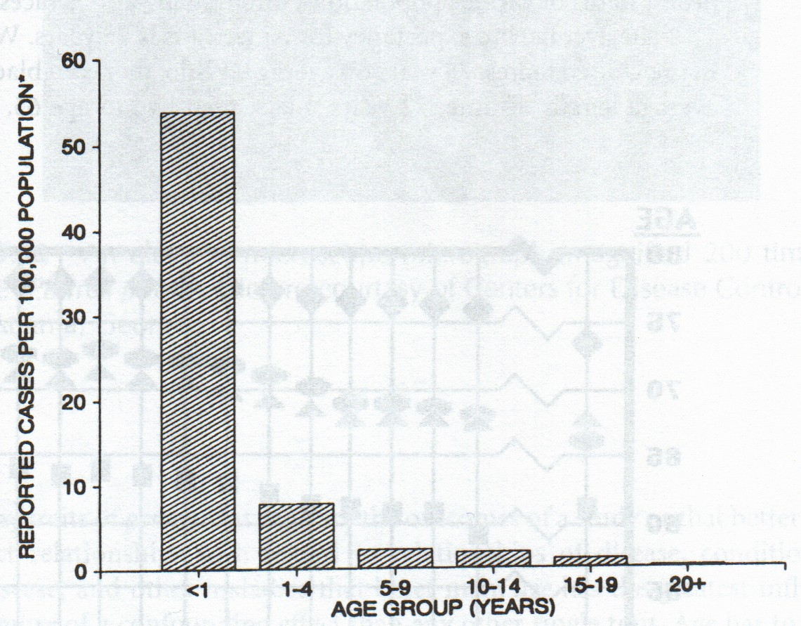
Age

Slide 59
Time
WHEN does the disease occur?
  “Temporal”
  Range from hours to decades
Type of disease dictates “time” element to be used
Graphic format often used
  y-axis (vertical) - frequency
  x-axis (horizontal) - time

Slide 60
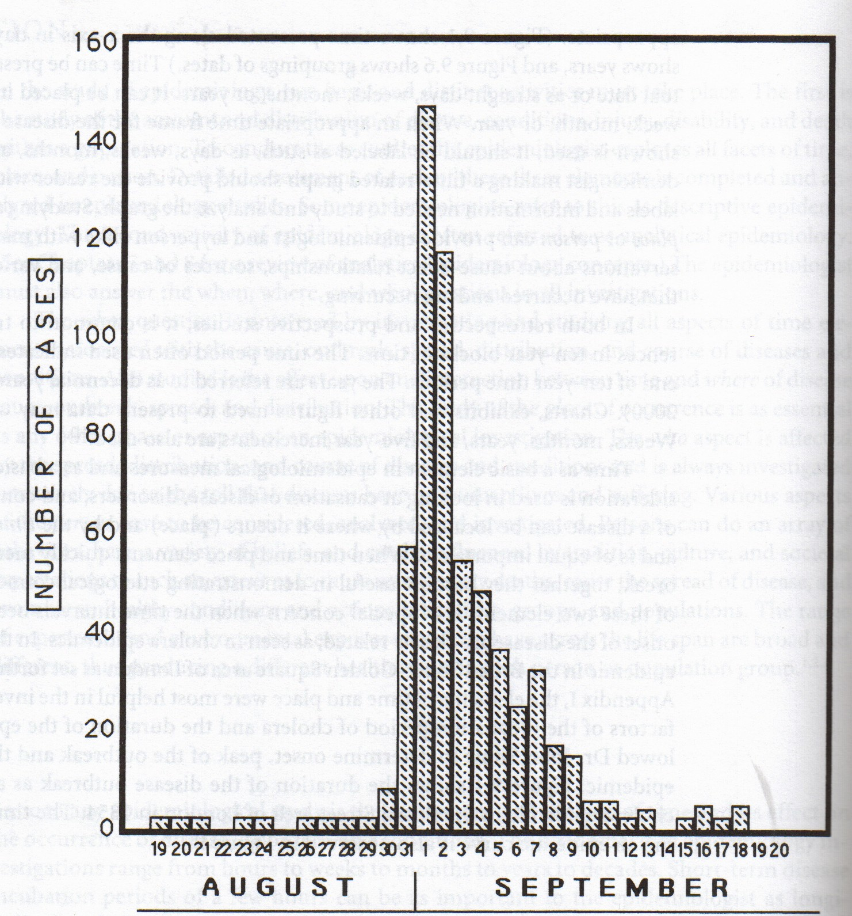

Slide 61
Characteristics Relating to Time
Secular change (long-term)
Point epidemics (short-term)
Cyclic trends
Seasonal variation

Slide 62
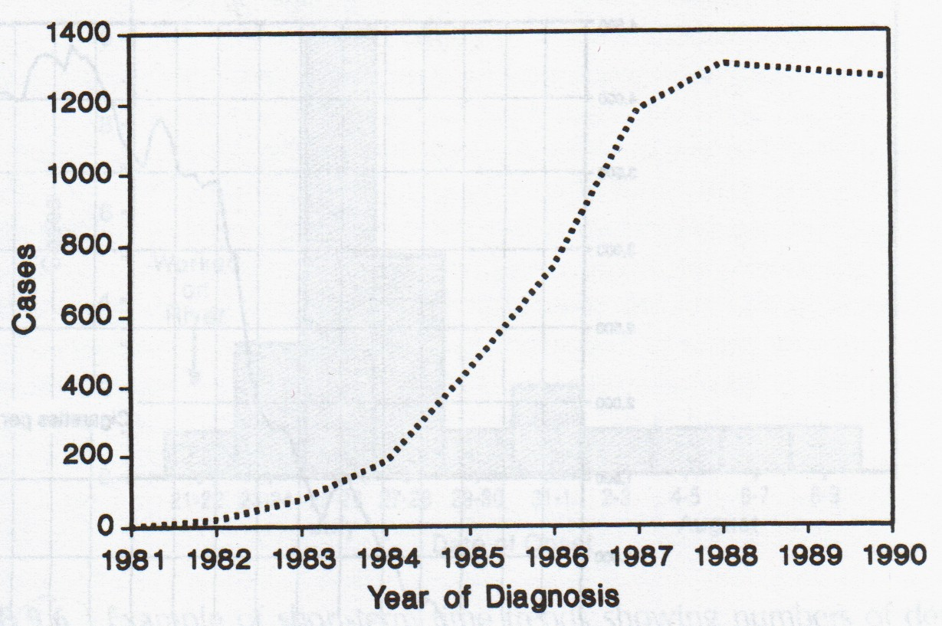
Secular Change

Slide 63
Cyclic Trends
Cyclic trends may be either long-term or short term events.
Some are “seasonal” while others are cyclic due to other factors:
  Immigration
  School year
  Military deployment

Slide 64
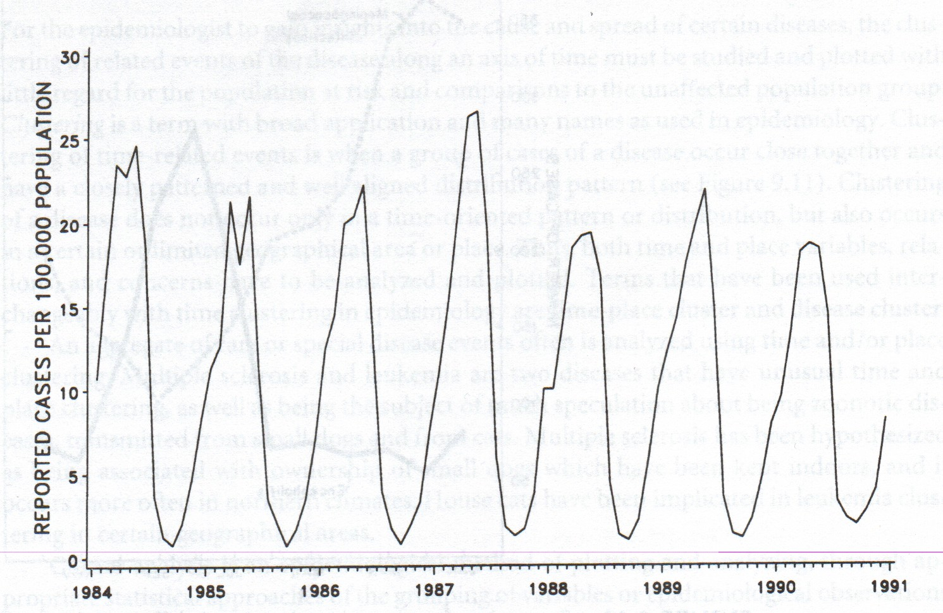
Cyclic Trends

Slide 65
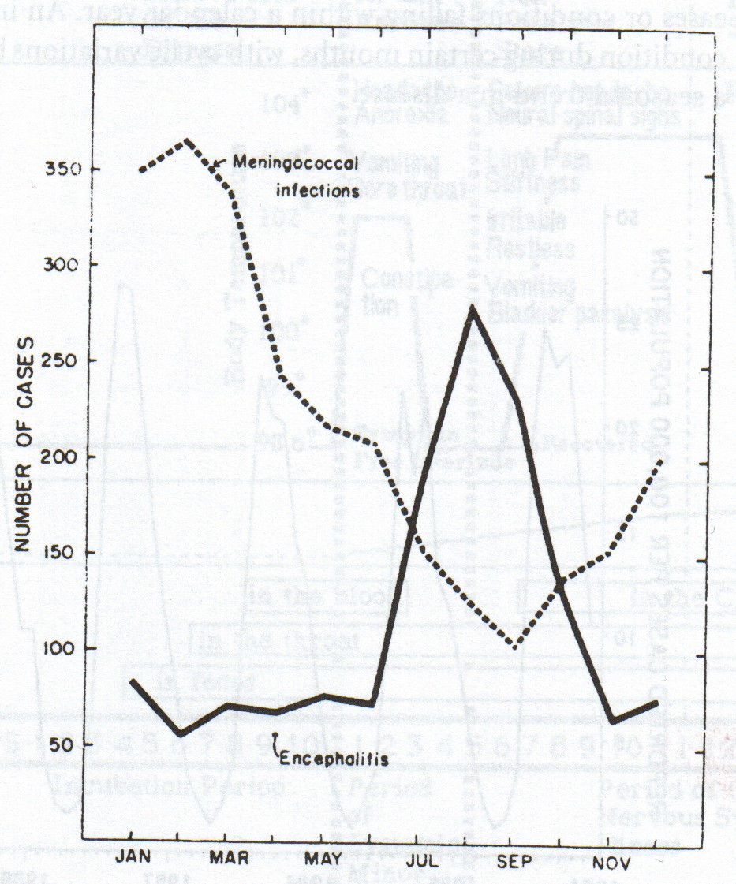
Seasonal Variation
Seasonal variation can be seen for some diseases or conditions falling within a calendar year

Slide 66
Time Clustering
Time clustering data can sometimes be used to trace the “beginning” to the introduction of a specific causal agent
  Thalidomide & birth defects
    First marketed in Europe in 1950’s as sleeping pill and to treat morning sickness in pregnant women
  Toxic Shock Syndrome
    Staphylococcus aureus infection in women using newly introduced hyperabsorbent tampons

Slide 67
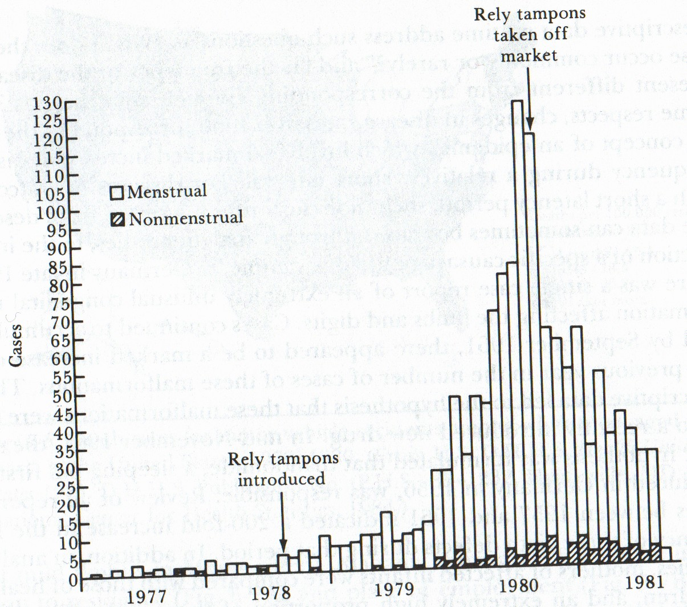
Time Clustering

Slide 68
Place
WHERE are the rates higher? lower?
Geographic location of source
Geographic location of reservoir

Slide 69
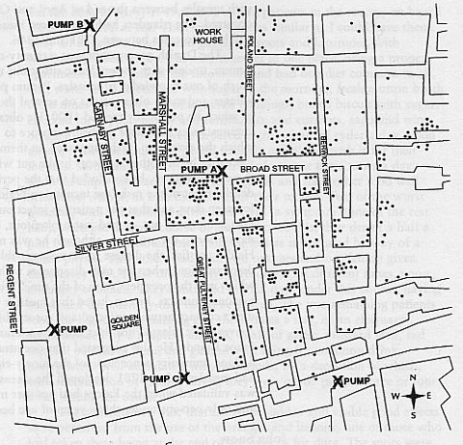
John Snow and Cholera

Slide 70
5 Criteria of Place
↑ Rate observed in all ethnic groups in the area
↑ Rate NOT observed in persons of similar groups inhabiting other areas
Healthy persons entering area get ill at same frequency
People who leave do NOT show similar levels
Similar levels of infestation in other species (if zoonotic disease)

Slide 71
Characteristics Relating to Place
International
Variation within countries
  Urban-rural
  Local
Building Maps

Slide 72
Interactions of
Time and Place
Time-place clustering
Migration

Slide 73
Measures
Types of research question in epidemiology
descriptive
occurrence/ frequency
analytical
association
Notes:
Simplified!

Slide 74
Measures of disease occurence
Prevalence
  Measures population disease status
Incidence
  Assess frequency of disease onset

Slide 75
Prevalence
Prevalence is defined as the number of affected persons present in the population at a specific time divided by the number of persons in the population at that time
Point prevalence – prevalence of the disease at a point in time e.g.September 15, 2014 – this is the usual meaning
Period prevalence – prevalence of the disease during a certain period e.g. one year

Slide 76
Prevalence
Number of cases of disease at a specific time
Population exposed at that time
Proportion of a population affected by a disease at a given time
Expressed as a percentage

Slide 77
Prevalence
Example of bilharziasis in Guadeloupe in 1979:
  Population 350,000
  Cases 96,200
  Prevalence = 27.6%
Number of cases = 96,200
Population = 350,000

Slide 78
Incidence
The incidence of a disease is the number of new cases of a disease that occur during a specified period of time in a population at risk for developing the disease
Incidence is a measure of risk
A person in the denominator must have the potential of becoming part of the numerator

Slide 79
Types of incidence
Type | Numerator | Denominator
Cumulative incidence | New cases of disease | Population at risk during entire period
Incidence rate | New cases of disease | Person-time of follow up
Incidence density | No. of episodes of disease | Person-time of follow up

Slide 80
Incidence and Prevalence
Prevalence = Incidence x Average Duration of Disease

Slide 81
The Natural History of Disease

Slide 82
Outline
Uses of natural history of disease
Case-fatality rate
Five-year survival
Life tables
Kaplan-Meier Method
Median survival time
Relative survival rate

Slide 83
Uses of the Natural History of Disease
To describe the severity of the disease so as to establish priorities for health services
To determine the prognosis of the disease
To establish a baseline for the disease for future comparisons
To compare the effect of different interventions on the disease

Slide 84
Events in the Natural History of Disease
Biologic onset of disease
Pathologic evidence of disease
Signs and symptoms of disease
Medical care sought
Diagnosis
Treatment
Outcome (cure, disability, death)

Slide 85
Some important issues about survival
At what point do we begin to quantify survival time?
How is the diagnosis made?
Prognosis is expressed in terms of death or survival from disease
Endpoints – death, cure, recurrence, disability, etc

Slide 86
Case-fatality rate
The number of people who die of a disease divided by the number of people who have the disease
Time is implicit because case-fatality rate is used for acute diseases

Slide 87
5-year survival
The percent of patients who are alive 5 years after treatment begins or diagnosis is made
Often used in cancer prognosis
Period of follow up – usually 5 years but can vary
Problems of 5-year survival
  Lead time bias
  5-year survival requires follow up of all the patients for at least 5 years

Slide 88
Life Table
Uses observed survival over predetermined periods of time
Unlike 5-year survival, life table does not require complete follow up of all patients
Uses all the available information on each patient
Uses the Multiplication Rule of Probability P(A) + P(B) = P(A) x P(B)

Slide 89
The Kaplan-Meier Method
Unlike the Life Table, predetermined intervals are not used
The endpoint (death) determines the end of the previous interval and the start of a new interval

Slide 90
Median Survival Time
The length of time that half the study population survives
It is less affected by extremes compared to mean survival time
To calculate the median survival time, we only need to observe the deaths of half the group

Slide 91
Surveillance

Slide 92
Surveillance:
Defined:
Systematic & Continuous Data Collection
Analysis and interpretation of data
Who, what, where, when of disease occurence in populations
System:
Data collection, analyses, and dissemination linked to public health action, intervention and programs

Slide 93
Measuring Disease Frequency
Has Several Components
Classifying and categorizing disease
Deciding what constitutes a case of disease in a study
Finding a source for ascertaining the cases
Defining the population at risk of disease, your denominator is KEY
Defining the period of time of risk of disease
Obtaining permission to obtain data
Making measurements of disease frequency
Relating cases to population and time at risk

Slide 94
Surveillance
Sources of Data
  Disease/Morbidity
    Hospitals, physicians, local health authorities
    Laboratories (serological, biological)
    Other (sickness absence records)
  Mortality (Cause of Death)
  Behaviours
    Smoking, alcohol consumption, risk factor surveillance
    Vaccine coverage data
  Environmental factors
    Vectors or reservoirs, ecosystem changes

Slide 95
Passive vs. Active
Passive Surveillance:
  Utilizes existing infrastructure of a country
  Even if reporting is required by law, there is no practical way of enforcing adherence
  Disease frequency is under reported.
  Useful in identifying outbreaks and trends over time.
  Health care providers report notifiable diseases on a case-by-case basis.
  Passive surveillance is advantageous because it occurs continuously, and it requires few extra resources.
  Cases in people without access to health care will go unreported.
Active Surveillance: (Diverse methods)
  Occurs when a health department is proactive and contacts health care providers or laboratories requesting information about diseases;
  Can involve case follow-up for verification
  While this method is more costly and labor intensive, it tends to provide a more complete estimate of disease frequency;
  Serological screenings
  Surveys (e.g. Behavioral Risk Factor Screening)
Use mixed approach when appropriate
Purpose of surveillance involves public health ACTION

Slide 96
Environment
Crowding
Atmosphere
Modes of communication – phenomena in the environment that bring host and agent together, such as:
  Vector
  Vehicle
  Reservoir

Slide 97
Host Factors
Genetic endowment
Immunologic state
Age
Personal behavior

Slide 98
Agents
Nutrients
Poisons
Allergens
Radiation
Physical trauma
Microbes
Psychological experiences

