Slide 1


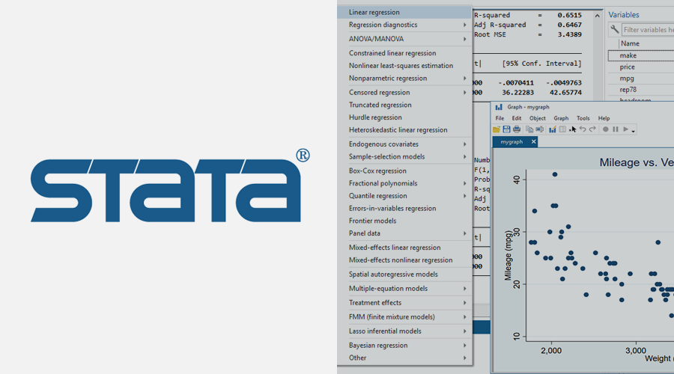


Introduction to data analysis using STATA, Excel, R, MATLAB

Slide 2
Definitions
Data: is the collection of facts and information
e.g.
Number of customers that visit your shop versus weather conditions
Number of patients who died from COVID-19 (may include Date and time of death)
Number of fruits from a plant versus different fertilizers
Analysis:
A process of cleaning, transforming, and modeling data to discover useful information for business decision-making.

Slide 3
Types of data
Data
Qualitative
e.g. documentaries, conversations
Quantitative
Categorical
Numerical
Nominal e.g. Gender, race, country
Discrete (count like number of episodes)
Ordinal e.g. Education level, SES
Continuous e.g. Age, number of customers

Slide 4
Database
Organized collection of data
Or: Data structure that stores organized information
For example. A database of patients in a hospital.
Normally stored in Excel, CSV file formats
ID No. | Names | Age | Sex | Symptoms | Diagnosis | Outcome (Dead or Alive)
1 | Jane Doe | 23 | F | Fever, Cough | COVID-19 | Alive
2 | John Doe | 57 | M | Flu, Fever, Chest pain | COVID-19 | Died
3
4

Slide 5
Phases of Data analysis
You need to know the type of data (database) that you have
You have to know the objectives of the analysis
-What do you want to achieve?
-What is the outcome? (No. of orders, who died and who recovered, No. of episodes of malaria in a year)
You need to have a plan (includes steps in data analysis)
-Identify software to use

Slide 6
Steps in data analysis
Data cleaning
Remove duplicates, outliers, empty data (N/A)….etc
Data visualization and Describing data (getting familiar with the data)
-Graphical
-Summary statistics e.g. means, frequencies, proportions
Modeling (several methods)
-Linear regression and multiple regression
-Logistic regression
-Etc

