Slide 1
Introduction to Bio-Econometrics
By
Bashir Ssuna, MD, MCEB, ImS
MAKERERE UNIVERSITY COLLEGE OF HEALTH SCIENCES

Slide 2
Definitions
Bio – Comes from Biology
Econometrics – Comes from Economics
Or Simply application of statistical methods to develop theories or test hypothesis in economics or finance
Bio-Econometrics –Methods devoted on explanation of the effect of socio-economic process on human being as a biological organism

Slide 3
What could this be?
Impact of socio-economic process such as industrialization on health outcomes like; cancer, respiratory diseases ( such as COPD, pneumonia)
Can be other indicators of health like; effects on weight, birth weight, morbidity and mortality and socio-economic process
Health and Economic systems such as cost-effectiveness of an intervention or drug or surgical procedure
-Health Insurance schemes are based on cost analysis

Slide 4
What are some of the models used?
Linear regression
-Linear relationship (outcome is continuous)
Panel data
-Outcome collected periodically
Logistic regression
-Outcome is binary (e.g. Died or lived)
Survival data (Time to event analysis)
    -Time to retirement
    -Time to find a new job
    -Time to develop a disease after a new factory

Slide 5
Time series and forecasting
  -Effect of a specific event over time
  -Forecasting: e.g. Predicting economic growth or predicting respiratory illnesses versus economic growth
Cost-effectiveness
Cost-benefit
Cost analysis

Slide 6
This all requires Data, But what is Data?
Data: is the collection of facts and information
Analysis:
A process of cleaning, transforming, and modeling data to discover useful information for business decision-making.

Slide 7
Types of data
Data
Qualitative
e.g. documentaries, conversations
Quantitative
Categorical
Numerical
Nominal e.g. Gender, race, country
Discrete (count like number of episodes)
Ordinal e.g. Education level, SES
Continuous e.g. Age, number of diseased people

Slide 8
What is a Database?
Organized collection of data
Or: Data structure that stores organized information
For example. A database of patients in a hospital.
Normally stored in Excel, CSV file formats
ID No. | Names | Age | Sex | Symptoms | Diagnosis | Outcome (Dead or Alive)
1 | Jane Doe | 23 | F | Fever, Cough | COVID-19 | Alive
2 | John Doe | 57 | M | Flu, Fever, Chest pain | COVID-19 | Died
3
4

Slide 9
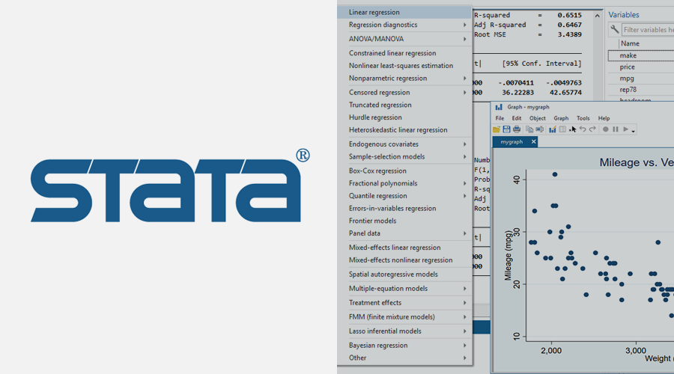

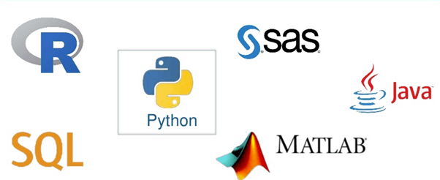
What are the Phases of Data analysis ?
You need to know the type of data (database) that you have
You have to know the objectives of the analysis
-What do you want to achieve?
-What is the outcome? (No. of industries created, who died and who recovered, No. of episodes of malaria in a year)
You need to have a plan (includes steps in data analysis)
-Identify software to use

Slide 10
Steps in data analysis
Data cleaning
Remove duplicates, outliers, empty data (N/A)….etc
Data visualization and Describing data (getting familiar with the data)
-Graphical
-Summary statistics e.g. means, frequencies, proportions
Modeling (several methods)
-Linear regression and multiple regression
-Logistic regression
-Etc

