Slide 1

Integrating Diabetes Mellitus Care into Tuberculosis (TB) Treatment in Uganda:
A Parallel Convergent Mixed-Methods Study
Dr. Bashir Ssuna, MBChB, MSc
Uganda TB Implementation Research Consortium
@UNIONCONFERENCE #UNIONCONF
worldlunghealth.org
Notes:
I recvised the spacing and capitalization and title

Slide 2

Background
Before COVID-19, TB has been the number one global killer from a single agent with approximately 25% of global TB deaths occurring in Africa
Uganda has a high incidence of TB (196/100,000 population) in a setting with high HIV prevalence (5.2%)
DM is increasing among persons with HIV & TB
Prevalence of PTB + DM is 2.5% and 18.8% in HIV
Rising rates of DM in low- and middle-income countries pose significant challenges for management and control of TB
@UNIONCONFERENCE #UNIONCONF
worldlunghealth.org

Slide 3
Problem (Tuberculosis and Diabetes Mellitus in Uganda: A Growing Syndemic)
Rising Diabetes Rates: The prevalence of DM among TB patients in Uganda ranges from 2.3% - 8.5%
DM in the general population increasing from 1.4% in 2016 to 4.6% in 2021.
Impact of DM on TB: DM complicates TB treatment, increasing the risks of treatment failure, recurrence, and mortality​​.

Slide 4
Problem cont. (Challenges in Integrating TB and Diabetes Care)
WHO Recommendations: WHO advocates for screening all TB patients for DM to address TB-DM comorbidity.
Gaps in Implementation: Uganda struggles with implementing integrated TB-DM management due to fragmented healthcare systems and poor DM care access.
Need for Research: There is limited evidence on barriers and facilitators to integrating DM care into TB and HIV treatment programs​​.

Slide 5
Justification (Why This Study is Critical?)
Evidence-Based Solutions: This study will identify barriers and facilitators to integrating DM care into TB programs
Providing data for policy change and clinical improvements in Uganda.
Long-Term Impact: The study will lay the foundation for sustainable interventions that reduce TB mortality and improve overall health outcomes and achieve End-TB strategy​​​.
@UNIONCONFERENCE #UNIONCONF
worldlunghealth.org

Slide 6
Implementation Science (IS) Overview
Scientific study of methods to ensure research findings and evidence-based practices are systematically adopted in routine healthcare and public heath setting
Bridging the Know-Do-Gap
Making sure interventions (e.g. vaccines) reach those who need them

Slide 7
Why IS?
40% of interventions fail after clinical trials
Helps researchers to understand and overcome barriers to adoption
Ensure that evidence-based Interventions are effetely delivered in real-world setting
By 2030, use of AI and IS will lead to a 30% increase in adoption of evidence-based policies

Slide 8
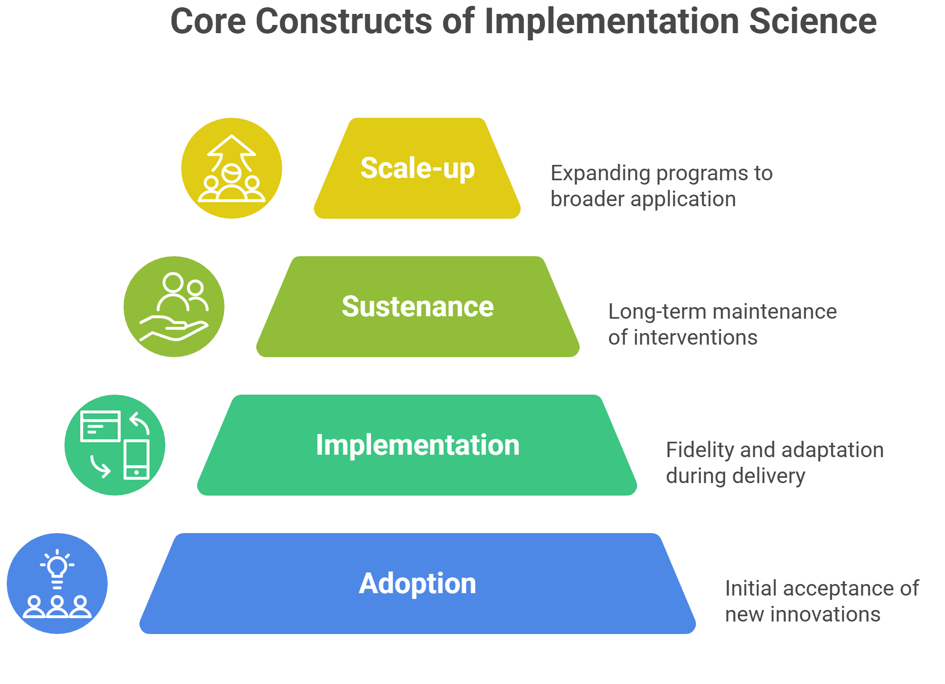

Slide 9

What is the Know-Do-Gap
Scientific advancements and evidence-based knowledge exist but are not consistently or effectively put into practice
It signifies the difference between what is known to be effective and what is actually being done in the real world.

Slide 10

What is Known?
WHO recommends screening all TB patients for DM and integrating DM care into TB programs.
DM increases the risk of adverse TB outcomes, including treatment failure, recurrence, and death.
DM prevalence is rising in Uganda, with 2.3%-8.5% among TB patients and 4.6% in the general population.

Slide 11
What is Not Being Done (Implementation Gap)
Uganda has not fully implemented integrated TB-DM care, despite WHO recommendations.
Fragmented healthcare services and limited access to DM care create significant barriers.
TB programs primarily focus on TB-HIV, neglecting comorbidity management like DM.

Slide 12

The Know-Do-Gap
The knowledge and evidence for integrated TB-DM care exists (Know).
However, actual implementation in Uganda is lacking (Do).
The gap: Barriers to integrating DM care into routine TB management remain poorly understood.

Slide 13
General objective
To assess the fidelity and implementation of the WHOTB-DM screening recommendation in a high HIV-TB burden setting
Specific objectives
To analyze the T-B DM care cascade in Uganda public health facilities
2. To determine the barriers and facilitators to integration of DM care into TB treatment in Uganda public health facilities

Slide 14
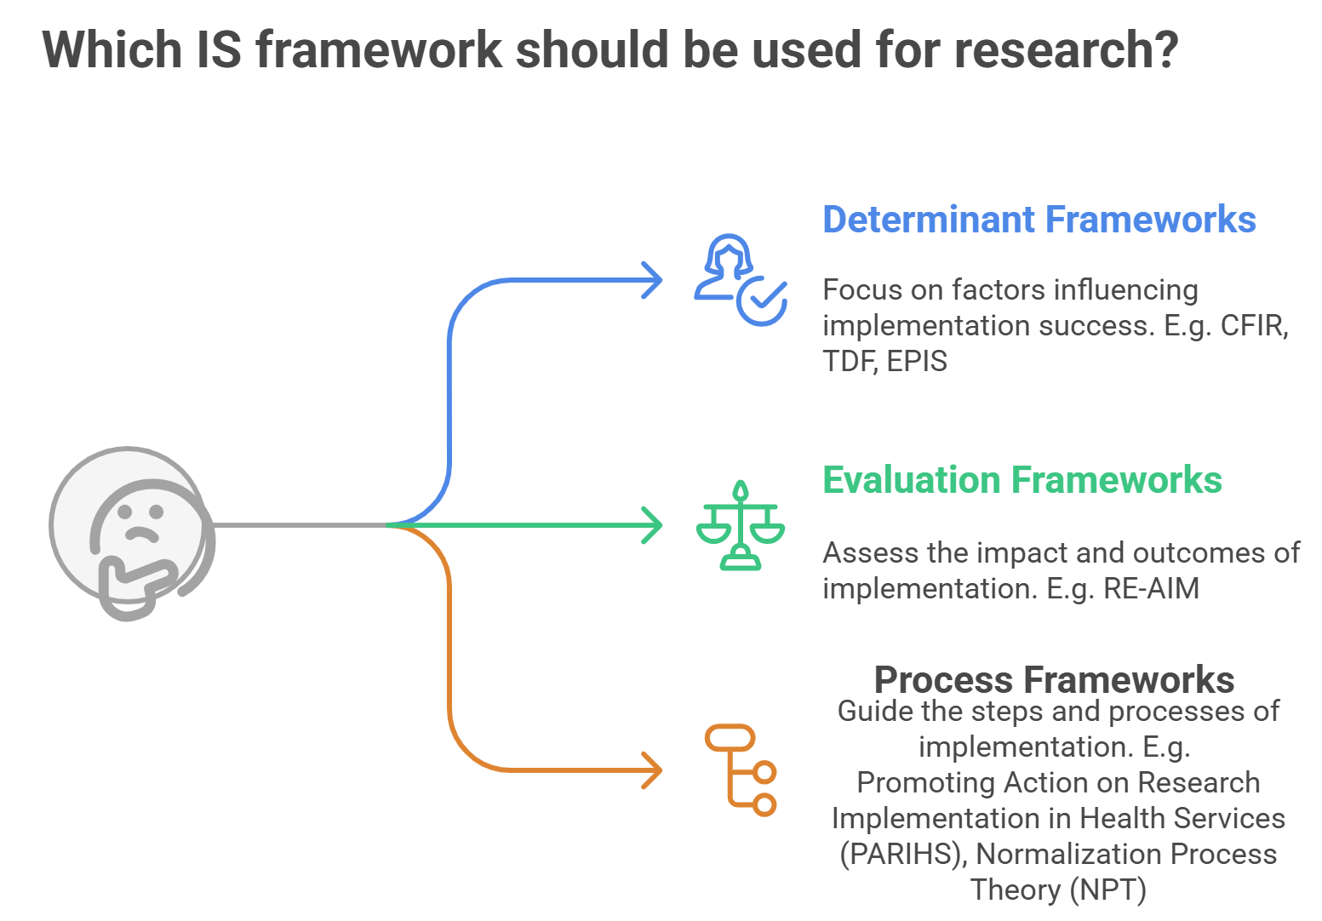
https://www.fic.nih.gov/About/center-global-health-studies/neuroscience-implementation-toolkit/Pages/methodologies-frameworks.aspx

Slide 15
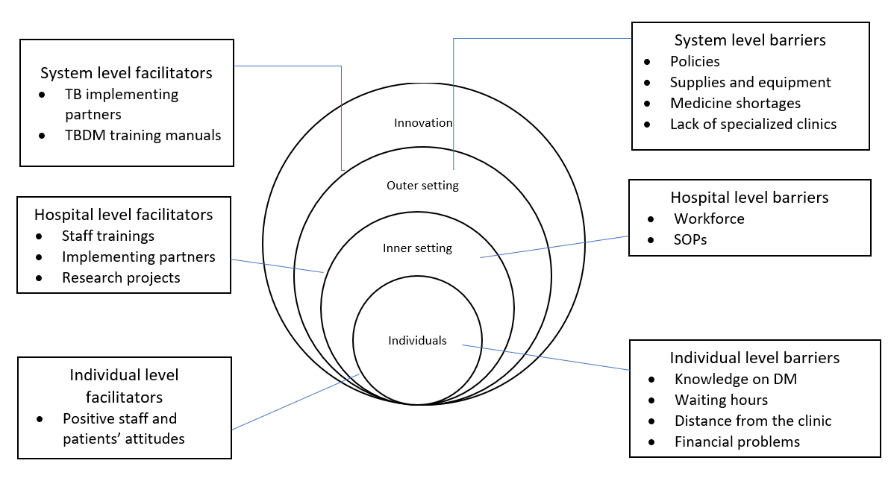
CFIR Framework
@UNIONCONFERENCE #UNIONCONF
worldlunghealth.org

Slide 16
METHODS – QUANTITATIVE PROCESS EVALUATION
Longitudinal cohort study
Nested within parent study of 285 consecutive adults with TB
Subgroup of 71 persons with TB with fasting blood glucose >7.1mmol/dl
Process evaluation tracking progress through TB & DM care cascades
Screened
Diagnosed
Initiated on DM Treatment
Retained in care during and after TB treatment
@UNIONCONFERENCE #UNIONCONF
worldlunghealth.org

Slide 17
METHODS – NESTED QUALITATIVE STUDIES
In-depth interviews
23 purposively selected cohort participants with HbA1C≥6.1%
6 providers involved in their care
Interviews were recorded, transcribed verbatim, translated, and analyzed with Atlas.ti to identify barriers and facilitators.
Mapped barriers and facilitators to TB-DM treatment integration
Consolidated Framework for Implementation Research (CFIR)
@UNIONCONFERENCE #UNIONCONF
worldlunghealth.org

Slide 18
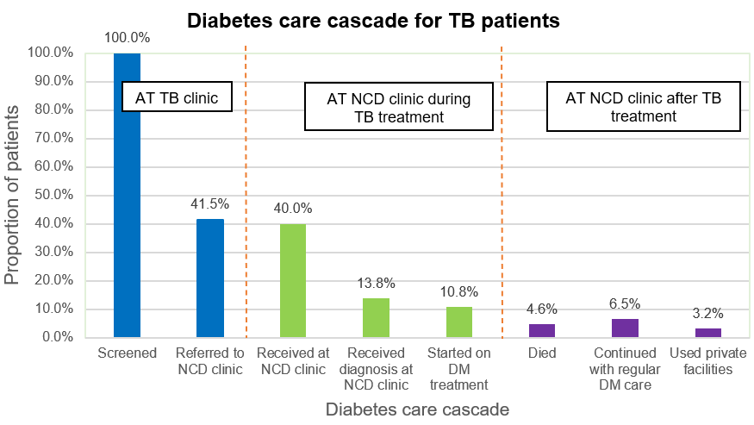
Results
(n=65)
TB treatment outcomes
81% completed treatment
@UNIONCONFERENCE #UNIONCONF
worldlunghealth.org
Notes:
I would remove the TB care cascade and just state the outcomes. If you did not collect

Slide 19
Conclusions and way forward
Persons initiating TB treatment in Uganda had a high prevalence of undiagnosed hyperglycemia
Most who were diagnosed with DM did not receive regular DM care due to a lack of integration of diabetes services with TB care
Enhanced integrated education, consistent test kits, and clearer policies are needed to improve TB-DM care
Provide a “one-stop shop” for patients with DM and TB
@UNIONCONFERENCE #UNIONCONF
worldlunghealth.org

Slide 20
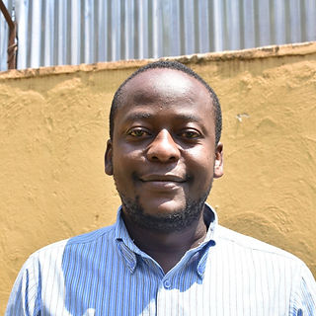


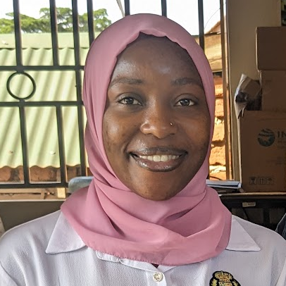
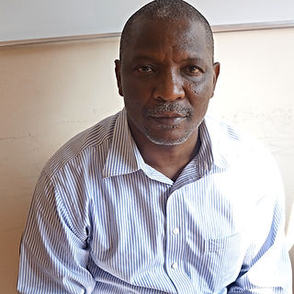


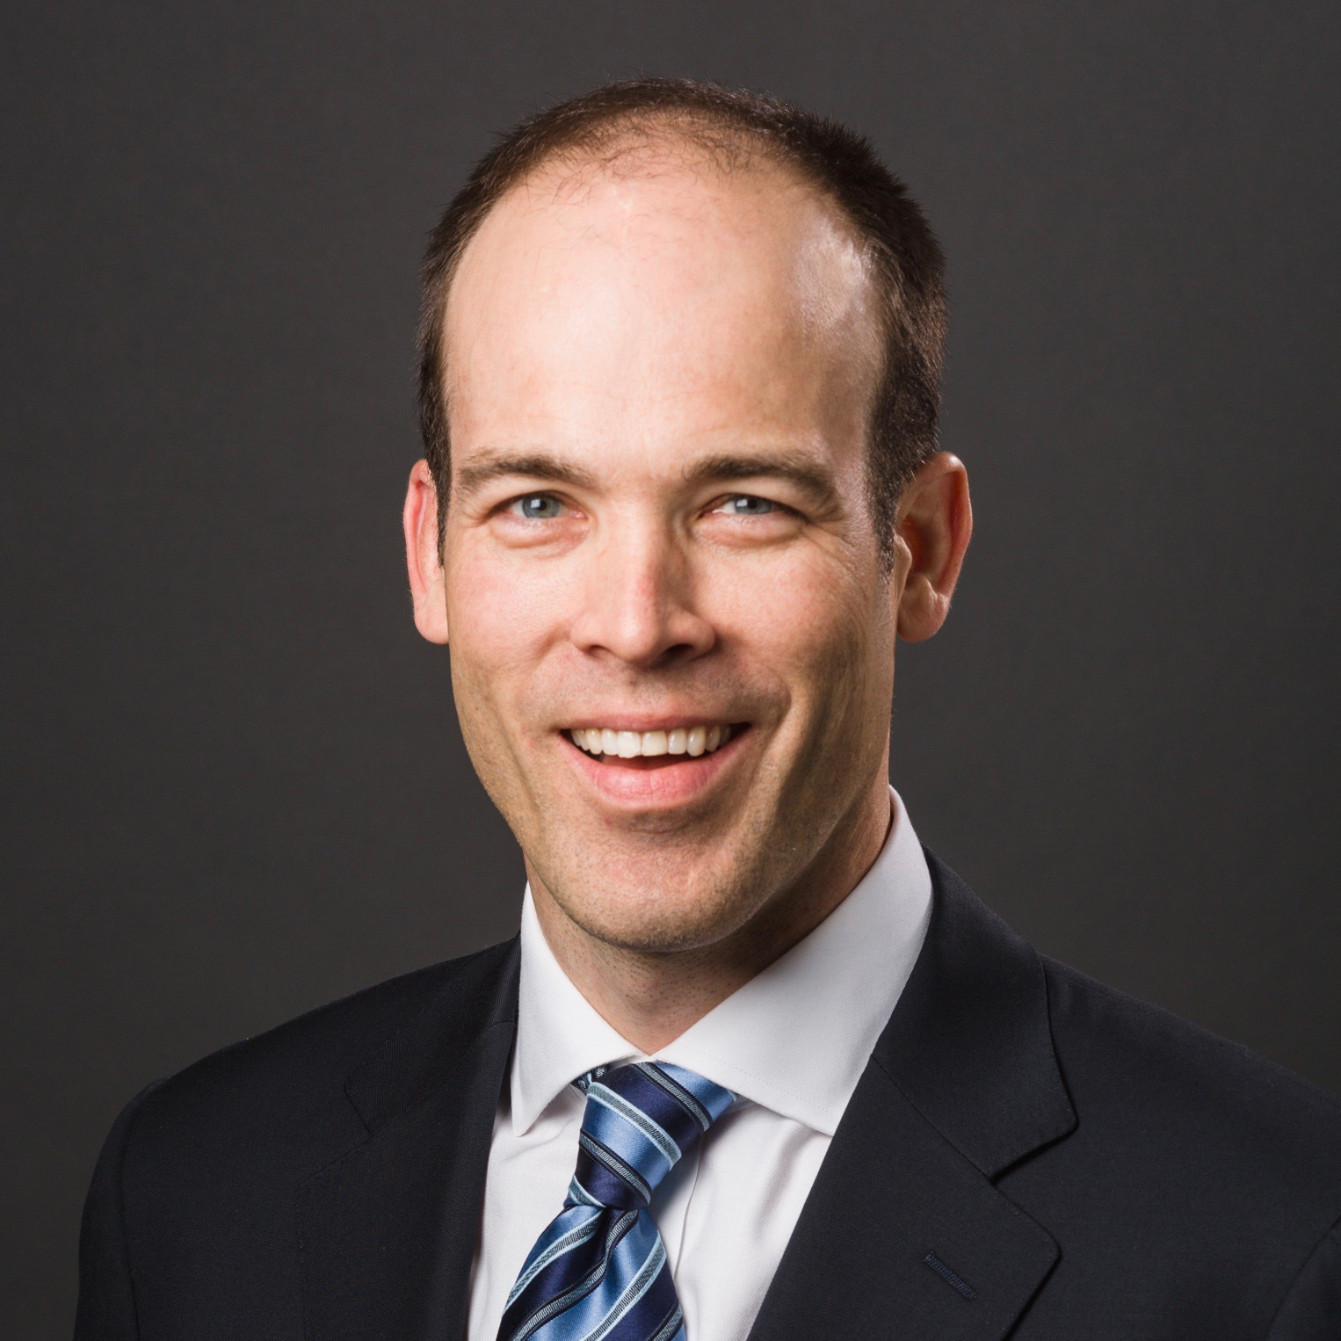

Acknowledgments
Study Participants
Joseph Ggita
Mari Armstrong-Hough
Funding
Patterson Trust (MAH)
Fogarty International Center and Office of AIDS Research of the National Institutes of Health under Award Number D43TW010540
Achilles Katamba
Madinah Nalubega
Lucian Davis
Thank You!
worldlunghealth.org
@UNIONCONFERENCE #UNIONCONF
worldlunghealth.org
@UNIONCONFERENCE #UNIONCONF

