Slide 1
Clinical Trials
Dr. Bashir Ssuna, MBChB, MSc

Slide 2
Randomized Controlled Trials
General principles

Slide 3
Definition of RCT
RCT means Randomized Controlled Trial
A research activity that involves the administration of a test regimen to humans to evaluate its safety, efficacy, effectiveness
An experimental design used to evaluate drugs and health interventions
RCTs do not include studies in animals, in vitro studies, historical comparisons

Slide 4
History of RCTs
Before 1950
After 1950
Types of RCTs
Scientific and Ethical principles
GCP
Consort

Slide 5
Experiments before 1950
During this period, there was an attempt at performing experiments but the rules and procedures were not yet established
Daniel of the Bible
Lindt and Scurvy
MRC Streptomycin Trials

Slide 6
Experiments after 1950
This period saw the gradual establishment of the principles of human experimentation
The major influences were the development of the scientific and ethical principles
Sir Bradford Hill and colleagues laid the foundation of modern RCTs

Slide 7
Scientific principles of RCTs
Equipoise
Concurrent controls
Counterfactual ideal
Random allocation
Definition of eligible participants
Definition of treatment schedule
Blinding and placebo
Objective evaluation
Statistical issues including sample size and analysis
7

Slide 8
Justification for Randomized Controlled Trials
RCTs are justified because of the problems associated with alternative approaches to clinical research namely;
Uncontrolled studies
Historical controls
Non randomized concurrent controls
In such non randomized studies it is very difficult to obtain a reliable assessment of treatment effect

Slide 9
Uncontrolled studies
The new intervention is studied without any direct comparison with a similar group of patients on more standard therapy
Problems of uncontrolled studies are;
-biased selection of participants
-biased assessment of outcomes

Slide 10
Historical controls
Comparison of current patients on new treatment with previous patients on standard treatment – tend to exaggerate value of new treatment
Problems of patient selection
Controls may be different because of different selection criteria
Problems of the experimental environment
Quality of records, changed criteria of response, change in patient care, invalidation of new rather than old patients more likely.

Slide 11
Non randomized concurrent controls
Non randomized methods are used to allocate participants to intervention or control group
Systematic allocation - e.g. date of birth, date of presentation
Judgement allocation – investigator or participant is allowed to exercise judgement in allocation
Major problem is predictability of allocation group, especially by investigator

Slide 12
Ethical principles of RCTs
RCTs have been shaped by the abuses of human experimentation that occurred in the past and gave rise to modern ethical principles namely;
Respect for persons
Beneficence
Non maleficence
Justice

Slide 13
Importance of RCTs
Evidence-based approach
RCTs provide evidence with least bias because of randomization, blinding and use of a control group
In terms of quality of evidence for health interventions, RCTs are at the top of the hierarchy of study designs

Slide 14
Indications for RCTs
When should an RCT be done? – when the following conditions exist;
Equipoise – the research question should reflect a situation of uncertainty in the scientific community
Ethical – the research question should be possible to address with research which is ethical
Feasible – the research question should be possible to address in an RCT
Relevant – the research question should be relevant and
justifiable.

Slide 15
Randomized controlled trial design

Slide 16
Types of RCTs
Clinical vs community
Therapeutic or preventive
Efficacy vs effectiveness
Individual- or cluster-randomized
Phase 1, II, III, IV (study or trial?)
One or more research questions (factorial)
Stratified randomization
N-of-1 to mega RCTs
Cross-over trials

Slide 17
Efficacy
Effectiveness
True impact attributable to the intervention
Randomize individuals, those most likely to benefit,
enforce compliance
Statistically more efficient
Impact when intervention applied under programme conditions
Randomize groups/communities, run feasibly efficient programme
Allows estimation of: acceptability, costs, indirect effects such as herd immunity

Slide 18
The clinical/field trials pathway:
production
GMP
Phase I Trials
Basic research
Phase II Trials
Biological Response
Phase III
Trials
Phase IV
studies
Safety
pipeline:
industry
public research institutions
others
PULL
Efficacy/Effectiveness
Clinical/Field trials: Critical instrument from product development to
implementation and thereby for product development
18

Slide 19
Factorial Design
Participant population
Aspirin n=500
Placebo-a n=500
β-carotene
n=250
Placebo-b
n=250
β -carotene
n=250
Placebo-b
n=250
A
B
C
D

Slide 20
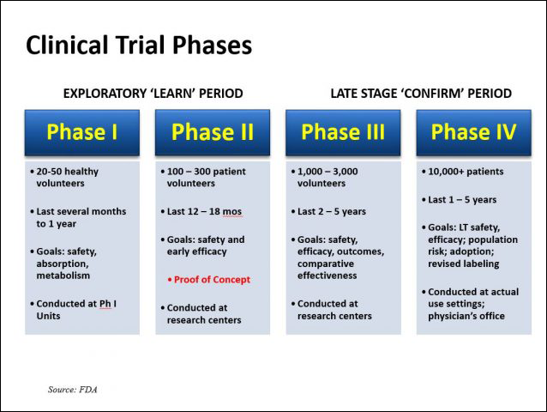

Slide 21
Designing a randomized controlled trial
23

Slide 22
Randomized controlled trial design
THE PRESENT THE FUTURE
No disease
Disease
Intervention
group
Study population
Random allocation
Dropouts, rejections
Control group
Inclusion & exclusion criteria
No disease
Target Population
Disease
Reference target population
24

Slide 23
Trial proposal/protocol
Title
Purpose and Rationale
Hypothesis
Specific primary & secondary objectives
Flow Chart / Table of study
procedures
Implementation plan
Staff recruitment & training
Field organization
Subject retention & follow up
Handling losses, withdrawals & protocol deviations
Intervention & co-interventions
Key outcome measures
Selection of study population & •
inclusion & exclusion criteria
Data collection &
management
Quality assurance and quality control
Adverse event reporting
Clinical & safety monitoring
Trial size estimates
Randomization and blinding
25
•
Plan of analysis

Slide 24
Problem statement and Justification (Rationale)
Problem statement
Antecedent factors
Consequences
Other factors
What is known, and what is not known
Justification/Significance
Policy e.g. Ministry of Health, WHO, etc
Shortcomings of policy
Utility of current study
26

Slide 25
Criteria for Target Population
High disease burden: baseline data available
Access for follow-up (also e.g. in rainy season?)
High quality field staff available
Supervision feasible
Community approval & support
Migration Obs! Permanent drop-out→Bias
risk
27

Slide 26
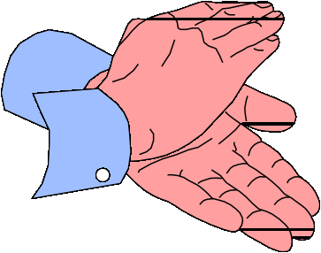
Stating the Hypothesis
Exposure factor or intervention
Zinc (1 RDA) given as a single oral dose
daily for 6 months
Study subjects
to children 6-35 months of age, in whom zinc deficiency is common
Expected effect size (state which measure)
will result in a reduction of ≥30% in the relative risk of (i.e. an efficacy of ≥30% against)
Outcomes
pneumonia during the zinc supplementation period
28

Slide 27


Objectives
(“action statement”)
To determine the impact of zinc administered to children with acute diarrhoea on its outcome.
Imprecise
To measure the effect of 10 mg oral zinc administered as a single daily dose to children aged 6-24 months with acute diarrhoea and some dehydration on stool output, episode duration and need for intravenous fluids
Precise

Slide 28
Randomization

Slide 29
Value of Randomization
Tends to balance baseline characteristics of the treatment groups
Aims to eliminate confounding due to measured and unmeasured risk factors (preventive trials) or factors predicting recovery (treatment trials)
Aims to provide an unbiased comparison between groups
Does NOT maintain balance after randomization

Slide 30
Randomization: minimizes confounding and selection bias
Individual or groups?
Simple or restricted (blocked, matched, stratified)?
Randomization distributes the study participants so that they have an equal chance of being allocated to the (two) different intervention groups
Did randomization succeed (differences in characteristics of groups at baseline)?

Slide 31
Steps in implementation of randomization
Generate randomization sequence: simple or restricted (i.e. blocked, matched or stratified)
Conceal allocation: sealed envelopes (SNOSE), numbered containers or other
Select patients based on inclusion & exclusion criteria
Obtain consent
Assign to receive intervention or control according to the randomization sequence
33

Slide 32
How to prepare a simple randomization scheme using random numbers tables
Decide allocation rule, e.g. for two groups
-Digits 0-4 to be assigned to intervention (group A)
-Digits 5-9 to be assigned to control (group B)
Start at a random place in the table, go in a pre- decided direction and record one single digit number for each study participant, e.g.
Participant no. | 1 | 2 | 3 | 4 | 5 | 6 | 7 | 8 | 9 | 10
Random numbers | 0 | 5 | 2 | 7 | 8 | 4 | 3 | 7 | 4 | 1
Allocation
A B A B B A A B A A

Slide 33
SIMPLE RANDOMIZATION WORKSHEET
Source of random numbers:
Allocation rule:
Participant | Random Number | Allocation
Number

Slide 34
BLOCK RANDOMIZATION (SIZE 4) WORKSHEET
Source of random numbers:
Allocation rule:
Participant | Random Number | Allocation
Number

Slide 35
Allocation using larger block size
Suppose block size is 12 (to be allocated to group A or
B)
Identify 6 two-digit random numbers between 01 and 12 ignoring numbers outside 01-12 & those previously selected
e.g. 02, 11, 07, 04, 01, 12 identified for allocating to
group A, reorganized (01, 02, 04, 07, 11, 12 or 1, 2, 4, 7,
11, 12):
1 2 | 3 | 4 | 5 | 6 | 7 | 8 | 9 | 10 | 11 | 12
A A | B | A | B | B | A | B | B | B | A | A

Slide 36
Stratified randomization
If: 1. some strong risk factor is known/suspected to be present in the study population, or 2. intervention impact is expected to be substantially different in subgroups.
Allocate in a way that equal numbers receive intervention or placebo within each subgroup
Example: Stratification by sex
100 subjects
60 males 40 females
Intervention | Control | Intervention | Control
n=30 | n=30 | n=20 | n=20
38
Analyze overall: intervention (n=50) vs. control (n=50)

Slide 37
Allocation using stratified randomization
Identify variables on which to stratify (1 or 2) Categorize each variable into two (or three) levels, e.g.
age: <12 and >12 months, weight for height (WFH): <70%
or >70% of WHO median
These form 4 strata: (i) age <12 and WFH <70%, (ii) age
<12 and WFH >70%, (iii) age >12 and WFH <70%, and (iv)
age >12 and WFH >70%
Separate randomization list for each stratum, using simple random or block randomization
Small block sizes used for several strata or having many
strata may be self defeating

Slide 38
Blinding

Slide 39
What is Blinding?
Single blind - participants are not aware of treatment group
Double blind - both participants and investigators unaware
Triple blind - various meanings
persons who perform tests
outcome adjudicators
safety monitoring group

Slide 40
Why Blind?
Maintains balanced groups during follow-up
Eliminates
cointervention
biased outcome ascertainment
biased measurement of outcome

Slide 41
How to perfom blinding
individually labeled containers?
Few codes?
Only two types of containers (A & B): easily un-blinded

Slide 42
Is it really blinded?
Difficult even for drugs
identical placebo difficult to prepare drug may smell, feel different, taste (yes, participants may taste it!)
drug may cause side effects → unblinding
test results may unblind

Slide 43
Why Not Blind?
Impossible
surgery
exercise
diet
education
Possible, but
dangerous
painful
cumbersome

Slide 44
What if You “Can’t” Blind?
Be courageous
Do the best you can
minimize differential cointervention
blind those measuring outcome
use “hard” outcomes
Measure degree of unblinding

Slide 45
Health Interventions

Slide 46
Types of Health Interventions
Therapeutic agents
Treatment or prevention of infection or of disease
Vaccines
Vector control
Environmental alterations
Education and behavioural change

Slide 47
Choice of Intervention
Maximize
effectiveness (highest tolerable dose)
safety (lowest effective dose)
generalizability
trial design/conduct (recruitment, compliance, blinding)
Consider
Dose
Duration
Route

Slide 48
Choice of the Control Intervention
Standard therapy
Alternate unrelated intervention
Placebo

Slide 49
Choice of Control
Inert placebo usually best, but might not be possible
Active therapy for control = equivalence trial:
H_{o}: not more than a stated difference between groups
H_{a}: one treatment better

Slide 50



Equivalence Trials
Advantage
answers clinical question
may be more ethical
Disadvantage
may require larger sample size
negative result may be due to low power
cannot tell if either better than placebo
Only reasonable if potential advantage of new therapy

Slide 51
Cointerventions
Unintended effective interventions
participants use other therapy or change behavior
study staff, medical providers, family or friends
treat participants differently
Nondifferential - decreases RR, efficacy and power
Differential - causes bias

Slide 52
Outcomes in Clinical Trials
Efficacy Outcomes
Primary
Secondary
Surrogate
Composite
Adverse Effects
rare
common

Slide 53
How to Proceed?
Measure all outcomes
Pick one primary outcome
estimate sample size*
FDA requirement
Make all the rest secondary*
Note: Some say OK to have several primary outcomes as long as sample size calculations indicate that power for all of these are are
adequate.
55

Slide 54
Adverse Events and Side Effects
Anticipated
use specific questions
Unanticipated
ask about general adverse experiences
Rare
sample size often inadequate
Common
multiple differences between groups
56

Slide 55
Outcome measures
Primary/secondary
Short term/long term
Intermediate/final
Biological/functional
Consider whether outcome measures
^{are:} • Feasible
Acceptable
Reproducible
Valid
Of clinical or public health importance
57

Slide 56
Measurement of disease outcome
Surveillance: Active or passive
Choice of measure of disease occurrence:
Incidence as Risk
complete follow-up (stable population!)
one event per subject
Incidence as Rate
dynamic population
incomplete follow-up
Incidence as Density
recurring disease: >1 event per subject possible
Prevalence
58

Slide 57
Estimating Sample Size and Power

Slide 58
Steps in estimating sample size for analytic studies
State null hypothesis (one- or two-sided)
Choose appropriate statistical test
Choose reasonable effect size/variability
Set α and β (two-sided α preferred)
Use appropriate table or formula to estimate sample size

Slide 59
Simple statistical tests
Test
Chi squared
T test
T test
Predictor dichotomous continuous dichotomous
Outcome dichotomous dichotomous continuous continous
Correlation coeff cont

Slide 60
Effect size
Effect size and variability - from literature, experts, or pilot study
When outcome is change in variable, use the standard deviation of the change and not the variable

Slide 61
Standardization
Dividing the effect size by the standard deviation of the outcome variable
Simplifies comparisons between effect sizes of different variables
The larger the standardized effect size the smaller the sample size
Usually 0.1 to 0.5

Slide 62
Drop-outs
Each sampling unit must be available for analysis
If loss to follow up is anticipated, adjust sample size accordingly
E.g. loss to follow up = 20%
Increase sample by factor of 1/1-0.20)

Slide 63
Clustered samples
Clustered samples distort the variability of the outcome variable
Adjust the sample size by multiplication with the design effect
Design effect = 2 (WHO guidelines)

Slide 64
Multivariate analysis
Multivariate analysis requires an adequate sample size
Rule of thumb is: 10 participants for each variable to be included in the multivariate analysis

Slide 65
Descriptive studies
Do not have predictor or outcome variables
Do not compare different groups
Concepts of power and null hypothesis do no apply
Sometimes descriptive studies also ask analytic questions
In such situation, estimate sample size for the analytic study as well

Slide 66
Steps in estimating sample size for a descriptive study
Estimate the standard deviation of the variable of interest
Specify the desired precision of the confidence interval
Select the confidence level for the interval (95%, 99%)
To use table, standardize the total width of the interval(SD/width of interval)

Slide 67
Fixed sample size
For secondary data analysis
For review of articles to determine whether the study had the power to show a difference
Use the tables or formulas and work backwards to estimate the power or the effect size

Slide 68
Strategies for minimizing sample size
Use continuous variables
Use paired measurements
Use more precise variables
Use unequal group sizes
Use a more common outcome

Slide 69
Role of chance: sampling error
TRUTH
STUDY FINDINGS | Intervention better than control | Intervention same as control
Intervention better than control | Correct conclusion Power (1-β) | α error (type 1)
Intervention same as control | β error (type 2) | Confidence interval
Not incorrect
conclusion (sigh!)
Confidence (1-α )
Correct conclusion
Confidence (1-α )
71

Slide 70
Calculating trial size to achieve adequate power
COMPARISON OF TWO MEANS
(z₁ + z₂)² × 2(s²) (μ₂ – μ₁)²
n =
WHERE
n = Sample size per group
z₁ = 1.96 for α error of 5% (95% confidence level)
z₂ = 1.64 for 95% power
= 1.28 for 90% power
= 0.84 for 80% power
s = Standard deviation of the outcome in control group
μ₂ – μ₁ = Minimum meaningful difference between means of intervention & control group
72

Slide 71
COMPARISON OF TWO PROPORTIONS
(z₁ + z₂)² 2 p (1- p) (p₂ – p₁)²
n =
Where
n z₁
= Sample size in each group
= 1.96 for 95% confidence level
z₂ | = = = | 1.64 for 95% power 1.28 for 90% power 0.84 for 80% power
p₁ | = | proportion in intervention group
p₂ | = | proportion in control group
p₁ + p₂
p
=
= average of p₁ and p₂
2
p₂ – p₁
= Minimum meaningful difference in proportions between
intervention and control groups
73

Slide 72
Sample size for adequate power: Comparison of two proportions
(z1 + z2)² × 2 p(1− p)
n =
( p2 − p1)²
Proportion that get outcome in the control group (p2) | 0.01 0.002
Proportion that get outcome in the intervention group (p1)
Average of p1 and p2 (p) | 0.006
95% confidence or 5% alpha error (z1) | 1.96 1.28
90% power or 10% beta error (z2)
Number of subjects required in each group (n) | 1956
RR | 0.20
% Protection or treatment effect | 80.0⁷⁴

Slide 73
Not only the targeted protection, i.e. the relative difference between the incidence in the control and intervention group but also the absolute value of the incidence is important for the sample size requirement
50% protection
30% protection
14000
14000
12000
12000
Sample size per group
Sample size per group
10000
10000
8000
8000
6000
6000
4000
4000
2000
2000
0
0 %
10 % 20 %
Risk in control group
0
30 %
0 %
10 % 20 %
Risk in control group
30 %
75

Slide 74
COMPARISON OF TWO RATES
(z ₁+ z₂) ² (r₁+ r₂) (r₂ - r₁)²
y =
Where
y = person-years in each group
r₁ = rate in intervention group
r₂ = rate in control group
z₁ = 1.96 for 5% alpha error
z₂ = 1.64 for 95% power
= 1.28 for 90% power
= 0,84 for 80% power
r₂ – r₁ = Minimum meaningful difference in rates
between intervention & control groups
76

Slide 75
EXERCISE 1
Intervention: age
Outcomes:
Insecticide-treated bed nets for children 0-4 years of
Death rate from malaria
Spleen “rate” (proportion of children with palpable
spleen)
C) Mean PCV
Death rate from malaria
Death rate from malaria in control group (r₂) = 10/1000 child-
A)
years
If intervention is expected to result in a relative reduction in malaria mortality rate by at least 30%,
Death rate in intervention group (r₁) = 7/1000 child-years z₁ = 1.96 for 95% confidence (5% alpha error)
z₂ = 0.84 for 80% power,
n= ?
77

Slide 76
PROPORTION OF CHILDREN WITH PALPABLE SPLEEN
Proportion in control group (p₂) = 40%
If the intervention is expected to result in a relative reduction in
B)
spleen “rate” by at least 25%,
Proportion in intervention group (p₁) = 30%
Power = 90%, z₂ = 1.28
Significance level 5%, z₁ = 1.96
p ₁+ p₂
P =
=
2
n = ?

Slide 77
C) MEAN PCV IN INTERVENTION AND CONTROL GROUPS
Mean PCV in control group (μ₂) = 33.0 Standard deviation in controls (s) = 5.0
If the intervention is expected to improve mean PCV by at least
2 (40% of SD),
μ₂ - μ₁ = 2
For 90% power, z₂ = 1.28
For 5% significance level, z₁ = 1.96
n = ?

Slide 78
Sample size for adequate precision
COMPARISON OF PROPORTIONS
⎡
z1 ⎤ ⎡(R +1)
2
⎤
n = ⎢
⎥ ⎢
− 2⎥
⎣ln f ⎦ ⎣ R × p₂
⎦
WHERE
n = number in each group
R = Relative Risk or Prevalence Ratio
f is such that 95% confidence interval of R is expected to span R/f to R*f
p₂ = proportion in control group
90%CI→ z₁ = 1.65; 95%CI → z₁ = 1.96; 99%CI → z₁ = 2.58
80

Slide 79
EXERCISE 2
Prevalence of splenomegaly in control group = 40%
Relative Risk expected (R) = 0.75 Upper limit of 95% CI of R = 0.85 f = ?
p₂ = ?
n = ?
81

Slide 80
EXERCISE 2
Efficacy of rotavirus vaccine against hospitalization due to rotavirus diarrhoea = 80%
Rotavirus diarrhoea hospitalization risk in controls =
1%
Lower limit of 95% CI of efficacy = 70%
R | = | ?
p₂ | = | ?
f | = | ?
n | = | ?
Also calculate sample size for adequate power (90%) for
the same situation.
82

Slide 81
Sample size for adequate precision
COMPARISON OF INCIDENCE RATES
2
₌ ⎡ z1 ⎤ ⎡ R + 1⎤
e
2
⎢ln f ⎥
⎢⎣ ⎥⎦
⎣
⎦
R
WHERE
e₂
R
= expected number of events in comparison group
= Rate Ratio
f is such that the confidence interval of R is expected to span R/f to Rf
90%CI→ z₁ = 1.65; 95%CI → z₁ = 1.96; 99%CI → z₁ = 2.58

Slide 82
EXERCISE 3
Diarrhoea incidence rate year
Rate ratio (R)
Upper limit of 95%CI of R f = ?
e₂= ?
= 6 episodes / child-
= 0.7
= 0.8
Number of children to be followed up? For how long?

Slide 83
[ ]
Sample size for adequate precision COMPARISON OF MEANS
⎡z1 ⎤ ²
n = ⎢
s1 + s2
2 2
2
⎥
2 ×(s )
⎣ ^{f} ⎦
n = required number in each group s = S.D. of outcome in control group
(usually assumed to be
s₂=s)
2
s₁ = S.D. of outcome in intervention group
f is such that : 95% CI of D (=μ₁ - μ₂) is expected to span D
+ f
90%CI→ z₁ = 1.65; 95%CI → z₁ = 1.96; 99%CI → z₁ = 2.58

Slide 84
EXERCISE 4
Mean PCV of control group (μ₂)
= 33.0
S.D. of PCV of control group (s₂) | = | 5.0
Expected increase D (μ₁ - μ₂) | = | 2
95% CI of D (μ₁ - μ₂) n = ? | = | 1.5, 2.5

Slide 85
Study implementation

Slide 86
RCTs on Zinc and Pneumonia in Nepal
Community Based:
Palle Valentiner-Branth, PS Shrestha, R K Chandyo, M Mathisen, S Basnet, N Bhandari, RK Adhikari, Halvor Sommerfelt, and Tor A Strand A randomized controlled trial of the effect of zinc as adjuvant therapy in children 2–35 mo of age with severe or non- severe pneumonia in Bhaktapur, Nepal Am J Clin Nutr 2010;91:1–8.
Hospital Based:
S Basnet, PS. Shrestha, A Sharma, M Mathisen, R Prasai N Bhandari, R
K. Adhikari, Halvor Sommerfelt, P Valentiner-Branth, Tor A. Strand and members of the Zinc Severe Pneumonia Study Group
A Randomized Controlled Trial of Zinc as Adjuvant therapy for Severe pneumonia in Young children Pediatrics April 2012, 129:4
.

Slide 87
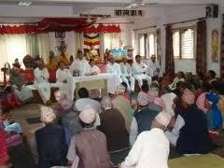
Community Acceptance
Critical elements for success of intervention study
Co-operation during conduct of trial
Acceptance of intervention
What needs to be done
Careful planning and investigation before start of trial
Appropriate discussion and explanation
to community leaders and potential participants
Feedback and interaction throughout course of study

Slide 88


Community Acceptance
Project Office
Field site

Slide 89
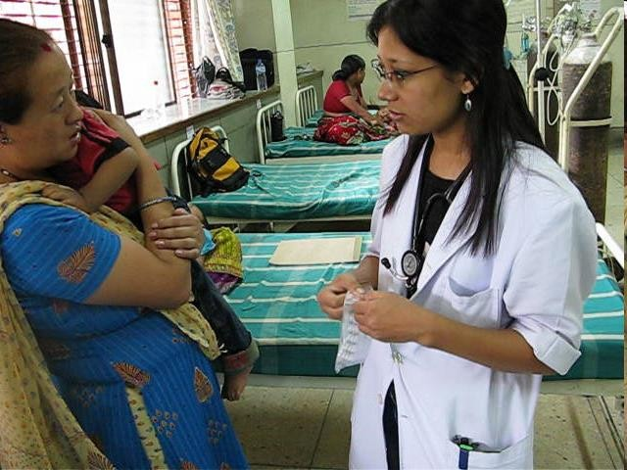
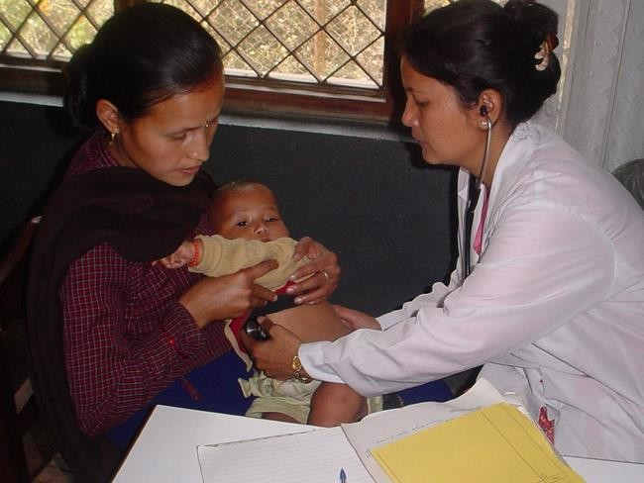
Staff recruitment
Need persons who are:
Dedicated and committed to study
Understand their role including importance of high quality work
For each position:
Clear job description
Minimum educational level

Slide 90


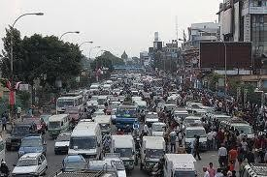
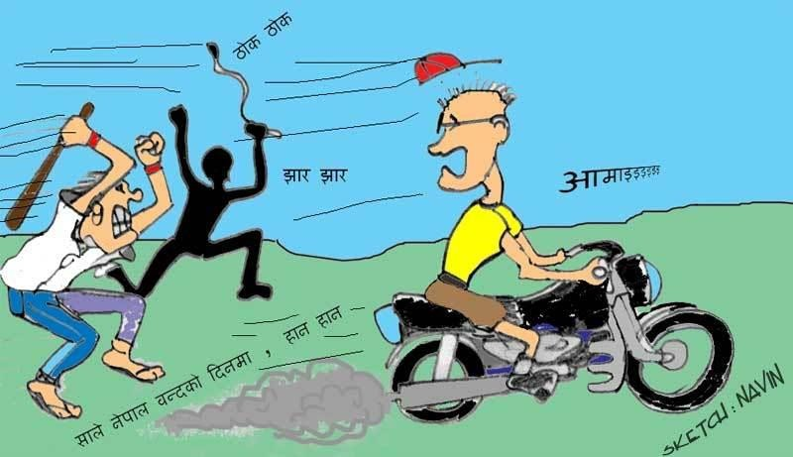
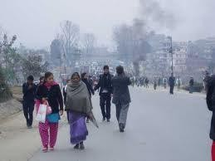
Potential disruption to study

Slide 91

Staff training
Before start of the study
While the study is going on or when necessary
Predefine the minimum required level of skills
Clearly define the task of a given worker
Give proper instructions including manuals
Make sure the staff have manuals where they work
Observe the staff while working

Slide 92
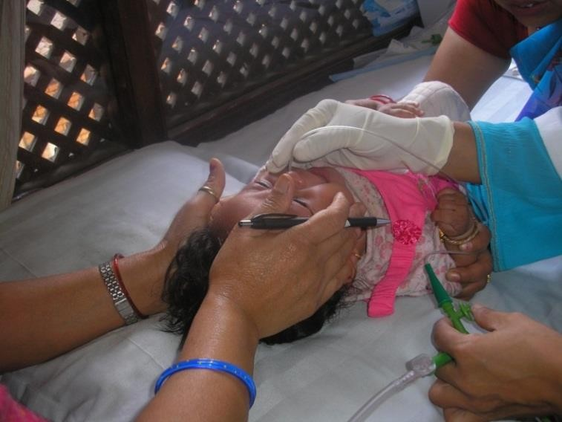
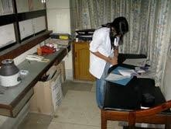
Staff Training Sessions
Theoretical
Practical
Practicing on forms for study
Study procedures – weight, height, vital signs
Collection and processing of biological specimens

Slide 93
Questionnaire design
Interview of study subjects may take place
Only once
Several times
In intervention studies
Initial cross sectional survey
Periodic surveys

Slide 94
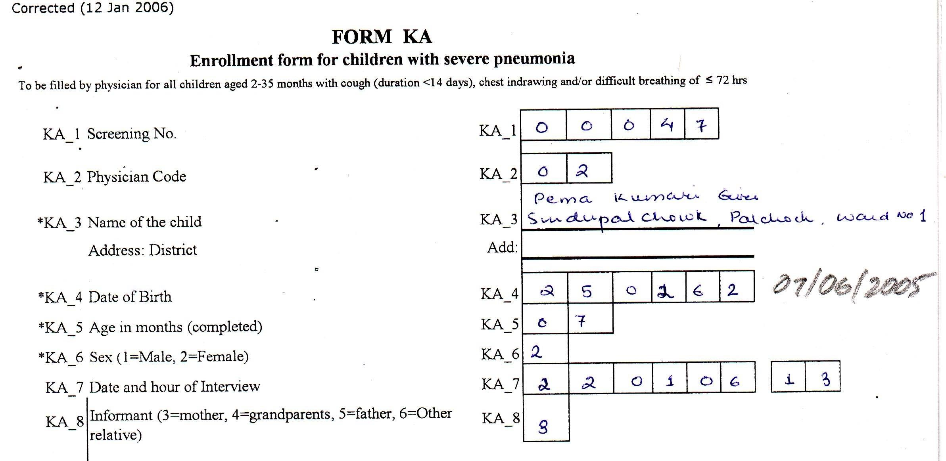
Instructions and Coding: An Example
“ Question KA_4: The date of birth will usually be given according to the Nepali calendar by the parents. You will be provided with a calendar that will give the date according to the English Calendar and so please look this up and fill in the English date of birth. In the event that you do not have the calendar, please ask the field worker/computer assistant to help you fill in the English date the next day

Slide 95
Standardization
Done to assess reproducibility of measurements/observations between observers or in same observer
Tested by using:
TEM (Technical error of measurement) for continuous variables
Kappa statistic for categorical variables

Slide 96
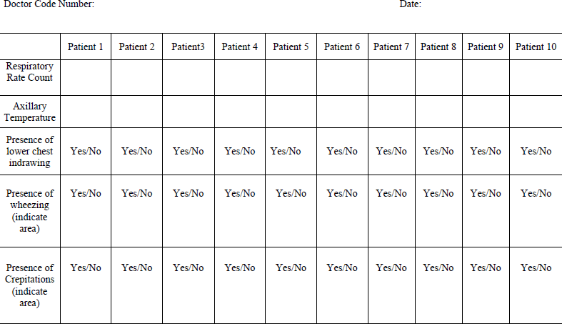

Slide 97
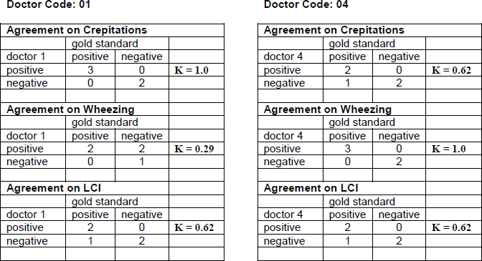

Slide 98
Pretesting
Of Study forms
Prepare draft of questionnaire
Pilot in field conditions
Analyze experience in pilot survey
Reformulate questionnaire and test again
Finalize questionnaire, send for printing and also finalize instruction manual.
Pilot study

Slide 99
Ensuring quality at design stage
Clear definition of outcome measures
Validity of the outcome measures
Sensitivity
Specificity

Slide 100
Major problems in data collection and their effect on trial results
Missing data: may lead to bias, some of the benefits of randomisation lost
Incorrect data: may lead to bias and/or excess variability
Excess variability: reduced ability to detect a real difference, lower power

Slide 101
Improving data quality
Study protocol
Detailed, clear description of what to do
Study manual
Everything about how to conduct the study Be sure to update all copies of the manual
Forms that have: only relevant questions, question as to be asked, continuous variables not categorized, structured to reduce chances of data entry errors, ID on each page
Pre-testing
104

Slide 102
Improving data quality – contd.
Training and standardization: Acceptable intra- & inter-observer variability
Consistent, well-organized workers selected through an objective process
Repeat assessments
Length measured 3 times & median taken
Blinding to minimize measurement bias
Data entry
Double entry, programs that identify missing, extreme or inconsistent values, early entry
Possible to track changes for data verification,
audits
105

Slide 103
For a good questionnaire ….
Do not adopt or copy from others, go through the process of development
Decide what information you need:
primary outcomes, secondary outcomes, characteristics that adequately describe the study population, possible confounders and effect modifiers
Formulate draft questionnaire
Informal followed by formal pilot testing Reformulate
Involve the field supervisors in the process, they then know the
problems
106

Slide 104
Good questions are
Relevant to obj…ect…ives. and outcomes
Written as asked, in local language, no need for referring to a
manual
Most close-ended, few open
Least inter-observer variability, high sensitivity and specificity
Appropriate recall period
Avoid categorization of continuous variables Use emmic terms when appropriate

Slide 105
Validity and reproducibility
As important for interviews as for other measurements
Use questions with high specificity and also high sensitivity, if possible
If no gold standard available, use questions with least inter- and intra-observer variability

Slide 106
Good interviewers are …
Usually neither too little nor too highly educated
Neat, steady, well organized, more structured than imaginative,
consistent than occasionally brilliant
More seen in systems where initial probation is used to eliminate bad ones
Selected through a well standardized, objective selection
process rather than a single authority decision

Slide 107
Quality control: focus on key data
Fastidious attention to all data is not possible, nor necessary
Primary and secondary outcome measures, informed consent and important baseline characteristics

Slide 108
Quality monitoring
Current to allow corrective action
Immediate feedback
Focused on key forms, procedures and drug handling
Record monitoring process and findings: assessment of data quality when interpreting study results

Slide 109
Monitoring of forms
Completeness
Internal consistency
Consistency with other forms

Slide 110
Monitoring of procedures
Extreme or unexpected (lab) values
Save specimens and original forms for rechecking
Equipment calibration
Daily calibration of weighing scales, thermometers
Internal and external QC: collection, preparation, transportation & result reporting Vitamin A: quality assurance program
Zinc: repeat samples, known samples

Slide 111
Monitoring of intervention/drug handling
Mislabelling
Analysis of contents of containers
Storage, shelf life
Dispensing, protocol deviations

Slide 112
Role of audits in improving quality
Random external audits even when no evidence of scientific misconduct
Pressurize adherence to protocol
Irritating for investigators especially if trivial errors are highlighted
Audits focused on a few key issues may enhance quality
Persistent diarrhea: Dilution of diet just before administration

Slide 113
Data collection: experiences from previous studies in Nepal
Field Organization
Data quality control
Data management

Slide 114
Field Organization
Defining organization structure before initiation
Allocation of responsibilities to key personnel
Defining the flow of information
Deciding which actions in the study need to be monitored and recorded (register)
Deciding what to do when something goes wrong

Slide 115
Organization Structure of Field
Trial
Project Manager
Researchers
Laboratory Techinchian
Field Doctors
Computer room Manager
Assistants
Supervisors
Entry clerks
Field workers

Slide 116
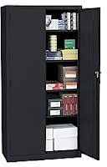



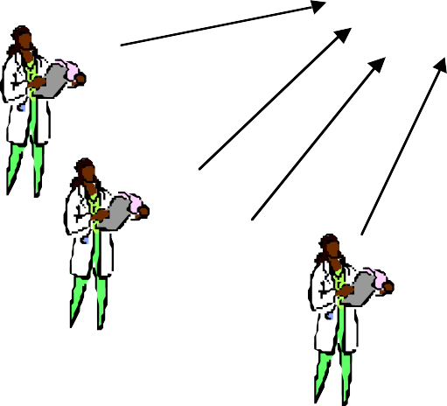
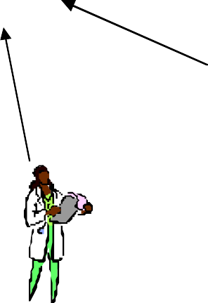




Storage of documents
forms and equipment
Main Office
Computer unit
Main Laboratory
Storage of samples
Field office
field lab

Slide 117













Katmandu
Bhaktapur
Field workers
45 minutes drive- 6 times per week
Supervisors:
Laboratory:
Physichians:
Laboratory:
Main office
Field office

Slide 118
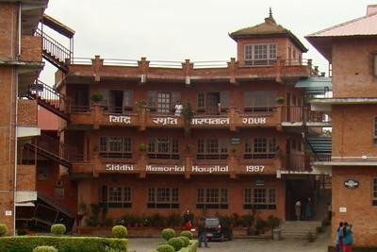
Field site activities
Field clinic
Enrolment and treatment
Laboratory facilities
Teaching facilities
Office
Field visits - Surveillance
Transport to/from the main office
Field workers, supervisors and doctors
Questionnaires
Consumables
Samples
Medicine/intervention

Slide 119

Data quality control
Steps where errors may occur:
Assessment / interview
Filling inn forms
Data entry

Slide 120
Registers and Manuals
Registers
For all questionnaires
For all actions
Transport of samples
Transport of questionnaires
Samples taken
Attendance
Daily tasks
Manuals
Study procedures
Field workers
Doctors
Laboratory procedures

Slide 121







Slide 122











Slide 123

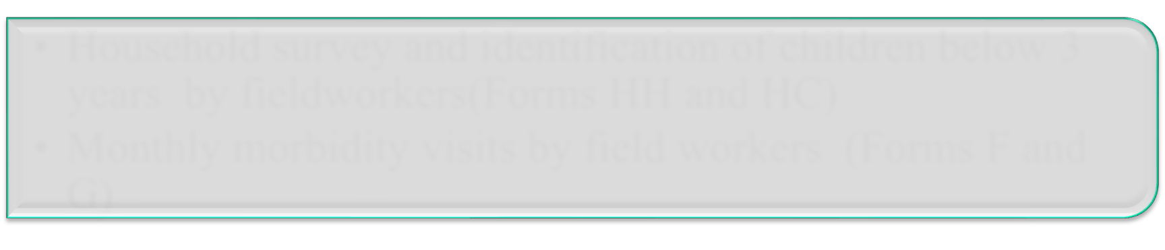

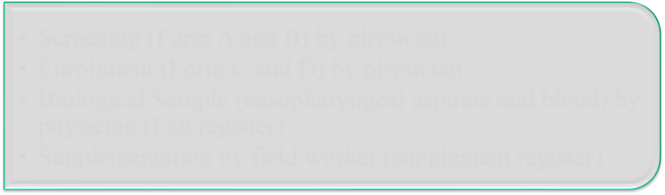

Defining flow of information
Household survey and identification of children below 3 years by fieldworkers(Forms HH and HC)
Monthly morbidity visits by field workers (Forms F and G)
Field
Screening (Form A and B) by physician
Enrollment (Form C and D) by physician
Biological Sample (nasopharyngeal aspirate and blood) by physician (Lab register)
Supplementation by field worker (supplement register)
Clinic
Field
Daily home visits by field worker till Day 14. (Form E)

Slide 124

Data Entry

Slide 125
Purposes of a good computer system
Reduce errors
Avoid “bulk” entry
Backup
Identify measurement or recording errors that can be corrected while the subject is still in the study
Double entry

Slide 126
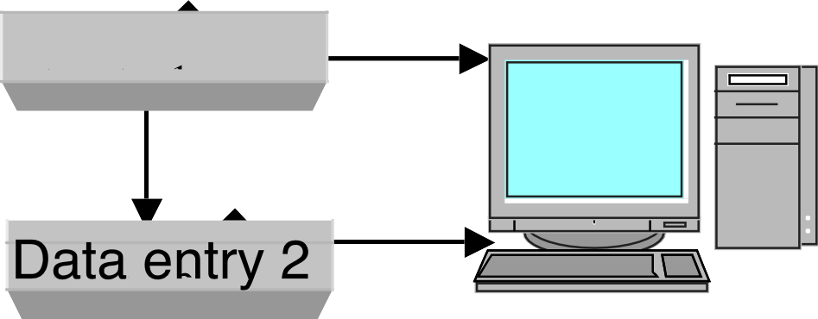



Forms from the field/ study site
if errors, return form to field ASAP
Validation Merging
Backup

Slide 127
Errors that can be detected
Typing (double entry)
Range
Completeness
Consistency/Logic

Slide 128
Preparations prior to the design of a database
Decide which variables to record
Design forms
Pretest forms
Modify forms
Decide range, logic, consistency and completeness checks

Slide 129
Checking Range
D_20 | Mid upper arm circumference (in mm) |  |  |  |  |  |  | D_20 |  |  | 80-160
D_21 | Weight (in kg) |  |  |  |  |  |  | D_21 |  |  | <30.0
D_22 | Height / Length (in cm) |  |  |  |  |  |  | D_22 |  |  | <110
D_23 | Weight for height <70% (according to NCHS standards) |  |  |  |  |  |  | D_23 |  |  | 1.2.9

Slide 130
Logic checks form E:
If no history of diarrhoea (E_12=2) then E_25- E_28=9.
Consistency checks
Compare form D to C, A and B:
If chsuno not equal to 99999 thenIs there an identical chsuno in form D (chsuno) compared to C (chsuno) AND enrolment date in D (D_2)=date of interview in form C(C_3) AND screening number(D_1)=screening number (C_1)

Slide 131
Data Entry Screen
Appear similar as the form / questionnaire
Clearly label the fields with the same numbers as in the form

Slide 132




Slide 133




Slide 134
Examples of checks that a computer can do
Length for age
Age
Uniqueness of Id number
Date
Symptoms and signs with the diagnosis in the questionnaires
Information collected from one questionnaire with previous gathered information of the same child
» Dates match
Serial number match
» Gender match

Slide 135
Software for data management
Excel
FoxPro
Dbase
Filemaker pro
Access
Oracle
EPI Info

Slide 136
Backup
Frequent
Rewriteable, not rewriteable
Different media and different location
File format
Database format
Text, rtf
Create routines

Slide 137

Remember!
Backups and the computerized files should not be accessed by others than the researchers and that personal information should be kept safely and according to international and national guidelines.

Slide 138
Cluster-randomized RCTs (=Community-randomized RCTs): Randomization of groups instead of individuals e.g. households, clinic practices, schools, communities
141

Slide 139
Indications for Community Trials
Community wide application e.g. environmental alterations
Logistically simpler to administer intervention to groups
Ethical considerations e.g. wedged entry of HepB vaccine
Risk of contamination e.g. behavioural
Benefits for community e.g. herd immunity
Comparison of delivery systems
142

Slide 140
Methodological issues
Randomization of communities: lack of statistical independence among members of a community (cause of design effect)
Sample size for cluster-randomized trials: larger than individually randomized trials
Analysis: precision of effect size lower in cluster-randomized trials than in individually randomized trials with the same number of subjects
Ethical issues
143

Slide 141
Number and size of communities
Large number of small communities?
Smaller design effect – statistically more efficient,
greater risk of contamination
Small number of large communities?
Somewhat larger design effect, less risk of contamination
Only two communities, i.e. 1 per group?
Useful strategies to avoid contamination:
Randomize large communities, study cohorts centrally located in each community
Corridors between randomized communities
Closed cohorts (avoid effects of migration)
144

Slide 142
Measurement of outcomes in community based intervention trials
Intervention targeted at specific groups: outcome measured in the same groups of individuals
Intervention applied at the whole community: outcome measured in a specific group of individuals
Intervention applied at the whole community to measure an overall public health effect: repeated cross sectional samples representative of the community
145

Slide 143
Developing behavioural change interventions
Identify behaviours that place populations at risk &
determine those modifiable
Select appropriate language & terminology for communication
Identify beneficial behaviours that can be reinforced
Decide target groups for health communication
Determine barriers to changing knowledge into practice
Pre-test the intervention & modify in a reiterative
process
146

Slide 144
Community randomization
Define mutually exclusive groups: geographically defined areas, households, classrooms etc.
Simple randomization to allocate groups to control or intervention: most suitable when number of communities is large (e.g. >200)
When number of communities small, matched-pair design often used: useful only if matching factor strongly associated with outcome; power and statistical issues. Usual factors cluster size, geographical areas, B/L event rates, SES
Stratified randomization is a sensible compromise: reduces risk of baseline differences and avoids statistical problems.
All subjects in a community receive either the test
intervention or standard treatment/placebo
147

Slide 145
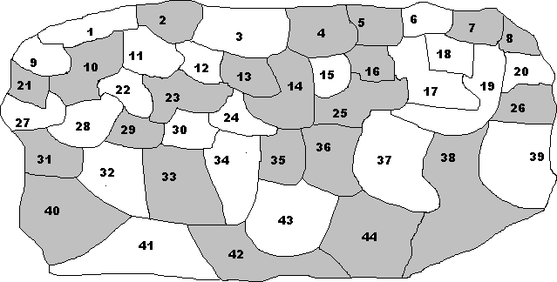
Community Randomization
148

Slide 146
Pair-matched allocation of small number of communities
Example:
8 Communities - A, B, C, D, E, F, G, H
Pair them according to socio-economic characteristics, e.g. A and E have similar socioeconomic status
Randomly allocate one of each pair to intervention and the other to control
 | AE | BC | DG | FH
Intervention | A | C | G | F
Control | E | B | D | H
149

Slide 147
Analysis of community-randomized intervention trials
Mean value derived from all subjects in each community Average value for one community treated as that of ONE individual
If enough communities to meet requirement of a t-test (n>30), use t-test to compare intervention and control communities
If lower number and unmatched randomization, Wilcoxon-
rank sum test (minimum 4 communities per group)
If matched-pair randomization, Wilcoxon-signed test
(minimum 6 communities per group)
153

Slide 148
When observations are not independent
Analysis of cluster randomized trials, trials with repeated measurements and entries.
Other situations where clustering occurs.

Slide 149
Basic statistical rule for most common statistical tests
Individual observations should be independent of each other
If they are not, we are likely to ”overestimate” the precision of our effect measures
Or in other words, we may by disregarding dependencies ”underestimate” sample size
i.e. variance estimates will be too low, confidence intervals too narrow, t-values too high, P-values are too low.

Slide 150
How can two observations be interdependent?:
Cluster randomized trial
Individuals participate in a trial >once
People from the same household participate in the same trial
An outcome is measured several times in an individual

Slide 151
How can we deal with clustering?
You need to calculate the
INFLATION FACTOR = DESIGN EFFECT
For this you need to know the:
Intracluster correlation coefficient (ICC)
Cluster size

Slide 152
How can we deal with clustering?:
Design effect=Deff=Inflation factor (IF)
IF=1+(m-1) x ICC
ICC= Intracluster correlation coefficient
ICC is a measure of how similar the individuals within a cluster are compared to all in the sample. Theoretical values: 0 to 1. If ICC is 0, the individuals within each cluster are not more similar to each other than to the rest of the sample.
m = average number of individuals in each cluster

Slide 153
IF=1+(m-1) x ICC
”Typical” ICC = 0.04*
“Usual values”: 0.01 - 0.1
Obtain these values from
Published studies
Pilot studies
Applicable for means, rates and proportions
Eldridge SM, (2003) Lessons for cluster randomised trials
in the 21st century: a systematic review of trials in primary care.
Clinical Trials
159

Slide 154
Examples of Published
Intracluster correlations coeff.
Outcome EPDS (Q1) EPDS 13 (Q1) EPDS (Q2) EPDS 13 (Q2)
Mother smokes (Q1) Mother smokes (Q2)
Breast feeding if child under 6 months age
Breast fed at birth
Child has sleeping problem (Q1) Child has sleeping problem (Q2)
Child's general healthvery healthy* (WCHMP) Minor illnessmore than other children (WCHMP)
> 2 minor illnesses in past 3 months (WCHMP) Accident in past year (WCHMP)
Behaviour problem (WCHMP) Hospitalised in past 6 months (WCHMP)
Child attended hospital in last two months Child seen GP in past 2 weeks (Q1)
Child seen GP in past 2 weeks (Q2)
Non-routine visits to GP by mother standardised to 1 year Non-routine visits to GP for child standardised to 1 year
Intracluster corr
0.029
0.0336
0.0239
0.0108
0.0267
0.088
0.0355
0.0137
0.0 (0.0049)
0.0 (0.003)
0.0287
0.0438
0.0479
0.0 (0.0135)
0.0206
0.0 (0.0126)
0.014
0.0 (0.0196)
0.0 (0.0161)
0.0277
0.0274
EPDS, Edinburgh postnatal depression score WCHMP, Warwick child health and morbidity profile
Reading et al. Arch Dis Child 2000;82:79-83
160

Slide 155
How do we adjust?:
adjusted variance = crude variance x IF
adjusted sample size (SS) = crude(SS) x IF adjusted SE=SE x √(IF)
SE=standard error IF=Inflation factor

Slide 156
Exercise 1
The calculated sample size in a clinical trial is 1000 individuals per group (individual randomization).
What is the required sample size when we use families as the units of randomization.
We assume that the mean family size is 5 (m=5), and that the intracluster correlation coefficient is 0.04.
Use the formula: IF=1+(m-1) x ICC

Slide 157
Exercise
The calculated sample size in a clinical trial is 1000 individuals in 40 clusters.
What is the mean cluster size?
You decide to increase the sample size to 1200. Use the formula: IF=1+(m-1) x ICC to answer the following question.
What is more efficient, to increase the number of clusters or to increase the cluster size?

Slide 158
Possible methods for adjustments
Summary measures for each cluster
adjust standard errors using the design effect - an approximation
robust variance estimates
general estimating equation models (GEEs)
multilevel modelling
Bayesian hierarchical models
others

Slide 159
When should we deal with clustering
When calculating the sample size
When analyzing the data
present estimates for the effect that are adjusted for the cluster effect
describe the design, how the observations are correlated and the number of clusters
report the intracluster correlation coefficient

Slide 160
Other situations when clustering occur
Clustering in a study when the clusters are not the units of randomization.
A subject can be randomized several times (thus the subject can be allocated to more than one treatment)
Individuals from the same household can be randomized (although household is not the unit of randomization)
Etc.

Slide 161
Intracluster correlation for continous variables
ICC
Mean squares values from an anova table
m = average size of clusters

Slide 162

Intracluster correlation for rates and proportions
ICC
k = number of clusters
X_{i} = number of positive cases (in the cluster) m_{i} = number of all cases (in the cluster)
m = mean cluster size
p = overall proportion of positive cases
168

Slide 163
Principles of analysis

Slide 164
Preparing Data for Analysis
Range, consistency & logic checks
Data screening
Outliers
Missing data
Data Exploration
Look at your data. Yourself!
Look at detailed distributions before computing summary measures
Gain insight into the nature of the data set
Look for errors, anomalies

Slide 165
Analysing a study
Study profile (describes participant flow)
Intention to treat analysis
Measures of effect size
Evaluating the role of chance: confidence intervals rather than p-values
Adjustment for confounding
Effect modification: subgroup analysis

Slide 166
Results in RCTs
Study profile
Baseline characteristics
Effect of intervention
RR, RRR, NNT
Survival analysis e.g. Kaplan-Meier analysis
Sub-group analysis
Adverse events

Slide 167
Assessed for eligibility (N₁ =…)
Consort Statement
Excluded (n=…)
Not meeting inclusion criteria (n =...)
Refused to participate (n =…)
Other reasons (n=…)
Randomized (N₂ =…)
Allocated to intervention (n=…) Received allocated intervention (n =…) Did not receive allocated intervention; give reasons (n =…)
Allocated to control (n =…)
Received allocated control measure (n =…) Did not receive allocated _{control measure} ; give reasons (n =…)
Lost to follow-up; give reasons (n =…)
Discontinued intervention; give reasons (n =…)
Lost to follow-up; give reasons (n =…)
Discontinued; give reasons (n =…)
Analysis
Analyzed (n =…) Excluded from analysis; give reasons (n = …)
Analyzed (n =…) Excluded from analysis; give reasons (n =…)
Flow diagram of the progress through the phases of a random¹i⁷z³ed trial

Slide 168
Trial profile
Eligible children at 16-18 weeks 230
Reason for exclusion Moving out: 12
Non consent: 8
Severely ill: 2
Randomized 208
Food Supplementation 104
Control 104
Lost to follow up Died: 1
Moved: 13 Refused further participation: 3
Lost to follow up Died: 2
Moved: 9 Refused further participation: 2
87 (83.6%)
Wt & Ln at 52
91 (87.5%)
174
wk

Slide 169
Intention to treat: a strategy for design, conduct & analysis
Design
Intention-to-treat essential for pragmatic trials
Justify in advance any inclusion criteria which when violated
would merit exclusion
Conduct
Minimize missing response on the primary outcome Follow up subjects who withdraw from intervention
Analysis
Include all randomized subjects in the groups to which they
were allocated
Investigate the potential effect of missing response
Reporting
Base conclusions on the results of intention-to-treat analysis175

Slide 170
Intention-to-treat analysis
2500 randomized to vaccine (1250) or placebo (1250)
1800 (800 vaccine, 1000 placebo) received 3 doses
400 (250 vaccine, 150 placebo) received only two doses
300 (200 vaccine, 100 placebo) received only one dose
Intention-to-treat analysis:
Outcome in all 2500 analyzed
Essential for clinical or public health policy
Per-protocol analysis:
Outcome in only 1800 analyzed
176

Slide 171
Summarization of numerical data
Measures of central tendency
Mean, median, mode
Measures of dispersion
Standard Deviation
Variance
Percentiles
Interquartile range
Range
177

Slide 172
Summarizing nominal data
Proportion
A part divided by the whole; numerator is part of the denominator. Risk is an important example of a proportion
Percentage
A proportion multiplied by 100%
Ratio
Two numbers divided by each other, e.g.: Proportion, Rate, Rate, risk ratio (=relative risk), odds ratio etc.
Rate
Not proportions but with events in numerator and
multiplier and time unit specified
178

Slide 173
Association or Correlation
Association or correlation is defined as excess or lower risk of disease in an experimental group when compared to a control group.
Common outcomes in RCTs include incidence, prevalence, and mortality.
The type of association will depend on the nature of the outcome variable e.g. continuous or nominal.

Slide 174
Measures of morbidity (incidence or prevalence of illness) and mortality (incidence of death)
Incidence
Prevalence
Mortality
Standardization

Slide 175
Step-wise approach to establish association
Step 1:
Is there an association between the INTERVENTION and the
OUTCOME?
Step 2:
Is there a statistically significant association between the INTERVENTION and the OUTCOME?
Step 3:
Is the association between the INTERVENTION and the OUTCOME of clinical or public health importance (=“significance”?)

Slide 176
Association between two variables: NUMERICAL
Correlation
Pearson product moment correlation coefficient
= r
r² = coefficient of determination = amount of variability in a variable determined by the other variable
r = 0-0.25(“no” association); 0.25-0.5(fair); 0.5-
0.75 (moderate); 0.75-1 (excellent)
Difference between means in experimental and control group

Slide 177
Relationship between two variables: NOMINAL
Incidence risk = risk = incidence proportion
Relative risk or Odds ratio
Relative Risk Reduction
%Efficacy = (1-Relative Risk) × 100%
Absolute Risk Reduction
Number Needed to Treat
Number Needed to Harm

Slide 178
Is there an association between the Intervention and Outcome?
Outcome
Yes No
a | b
c | d
a+b I_{E} = a/a+b
c+d I_{C} = c/c+d
Intervention
Control
a+c
b+d
Relative Risk
Or Risk Ratio (RR)
= a/a+b
c/c+d
Odds Ratio (OR) = a/b = ad
c/d 184bc

Slide 179
Is the association statistically significant?
Statistical association (or significance) exists when – The p-value is less than the alpha-level which
we decide to use, commonly <0.05
When the confidence interval corresponding to the alpha you choose as your cut-off does not include or touch the NULL. Examples:
If alpha=0.05 then a p-value indicating statistical
significance <0.05 and the upper 95%CI of an RR is
<1.0
If alpha=0.1 then a p-value indicating statistical significance <0.1 and the upper 90%CI an RR is
<1.0
185

Slide 180
Is the association clinically important (=clinically “significant”)?
Relative Risk Reduction or Efficacy
Absolute Risk Reduction
Number Needed to Treat

Slide 181
Relative Risk Reduction (RRR) or Efficacy
Relative Risk Reduction = Ic – Ie/Ic = 1-RR Where:
Ic = incidence risk in control group
Ie = incidence risk in experimental group RR = Risk ratio
Clinical significance exists if the Relative Risk Reduction is equal to or greater than a level which is determined by the importance of the outcome,
e.g. ≥5% if death, ≥ 35% if mild diarrhea

Slide 182
Absolute Risk Reduction (ARR)
ARR = Ic – Ie
This measure is harder to interpret than RR because it takes two features into account, the effect and the absolute risk. It is used to calculate:
Its main utility is in determining the Number Needed to Treat (NNT)

Slide 183
Number Needed to Treat (NNT)
Number Needed to Treat = 1/ARR
Clinically/Public health relevant if the NNT is small

Slide 184
Efficacy of zinc given daily for 4 months for prevention of pneumonia
 | Pneumonia |  | Total
Zinc | Yes 70 | No 930 | 1000
Placebo | 100 | 900 | 1000
Risk (incidence) in zinc group = 70/1000 = 0.07 Risk in placebo group = 100/1000 = 0.1
Measure of efficacy
Relative risk (=risk ratio) | = | 0.07/0.1 |  |  | = | 0.7
Relative risk reduction (=efficacy) | = | 1-RR | = | 0.3 | = | 30%
Absolute risk reduction | = | 0.1 – 0.07 | = | 0.03 | = | 3%
Numbers needed to treat (NNT) = 1/0.03 |  |  |  | = |  | 33 | 190

Slide 185
Odds ratio compared to Relative risk
AD
BC
ORdisease = ^{A B} = ^{A× D} =
C D B×C
_{RRdisease =} A (A + B) ₌ A×(C + D) ₌ AC + AD C (C + D) C×(A + B) AC + BC
The effect of adding the same positive number to both numerator and denominator is to make them similar, i.e. to make their ratio closer to 1:
RR is always closer to 1 than OR. OR is always more extreme than RR

Slide 186
Which measures of efficacy to report?
A relative measure of efficacy
Risk or rate (or density) of the target outcome among the controls
At least one absolute measure of efficacy (e.g. NNT)

Slide 187
Adjustment for confounding
RCT findings: Daily food supplementation to 4 month old infants resulted in 0.3 kg higher mean increase in weight when they had reached age 12 months (as compared to children in a control group)
Examine the size of baseline differences Baseline mean weight in Intervention group: 5.0 kg Baseline mean weight in Control group: 5.25 kg
P-values for baseline comparisons not relevant
If there are clinically important baseline differences,
adjust using appropriate (regression) models

Slide 188
Effect modification
Effect of intervention different between subgroups
Hypothtical: Effect of zinc supplementation during pregnancy on mortality in those with: Low birth weight: RR 0.4 (95%CI 0.24 to 0.68)
Normal birth weight : RR 0.90 (95%CI 0.82 to 0.98)
Effect modification should be biologically plausible and “statistically significant”
?Findings are only exploratory, not confirmatory because randomization was not stratified.? (Could it have been?)

Slide 189
Subgroup analysis
Effect of zinc on mean duration (hours) of acute diarrhoea (3-36 months olds)
Difference in means (95% CI)
-40 (-55, -25)
-60 (-80, -40)
All children | Zinc n=140 120 (60) | Placebo n=142 160 (65)
Age <12 mo | n=80 130 (65) | n=82 190 (70)
Age>12 mo | n=60 110 (70) | n=60 130 (90)
-20 (-50, 10)

Slide 190
Subgroup analysis
A priori decision?
Underlying hypothesis?
Was stratified randomization* done?
Was sample size estimated for overall effect only or also for age-subgroups?
Was formal test of interaction used?
Interpret the results…..
Baseline differences within subgroups likely if randomization done for all children and not in subgroups*
Only exploratory
197

Slide 191
Interpreting the results of a trial
Should the results be believed and to whom do these results apply?
Evaluation for internal validity: possible biases and their direction
Review study methods carefully
Generalizability
Study population & inclusion/exclusion criteria?
Interpretation of “negative studies” Calculate post-study statistical power and/or assess and interpret 95%CI carefully
Consistency with other studies
Qualitative and QUANTITATIVE review of the
literature
198

Slide 192
Internal validity
Are the findings reported likely to be true for the trial subjects?
Answer depends on whether there are important biases, which are unlikely if:
Randomization was appropriate & successful
Double-blinding appropriate & successful, in unblinded study: Concealment successful and measurements independent on whether in intervention or control group.
No or small number lost to follow up
Intention-to-treat analysis performed
199

Slide 193
Internal validity
Are the findings true for the study subjects?
Depends on selection or information bias
Generalizability or external validity
To what extent are the findings applicable to the population at large (Reference target
popul.)?
Depends on Inclusion & exclusion criteria
ACHIEVING INTERNAL VALIDITY IS THE FIRST
PRIORITY!
200

Slide 194
Generalizability = External validity
Study site/setting?
How were subjects identified for screening?
Inclusion and exclusion criteria?
In what kind of subjects was the study conducted? Findings are applicable to similar populations only
Internal validity is a pre-requisite
201

Slide 195
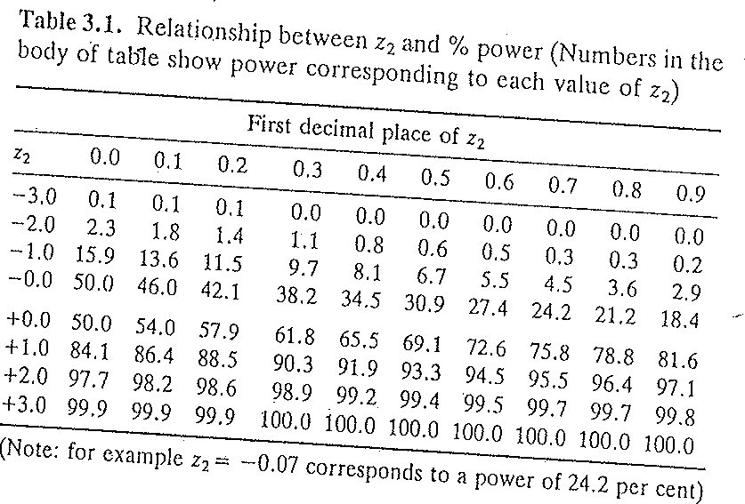

Interpretation of “negative studies”
Was no significant difference found because there was no real difference or because the study did not have the power to detect it?
Do a post-trial power calculation
n( p2 − p1)²
z2 =
− z1
2 p(1− p)
n | 500
p₂ | 0.4
p₁ | 0.3
z₁ | 1.96
p | 0.35
z₂ | 1.354968
Accept an interpretation that there is truly no intervention effect if the post-trial power is at least 90%. MUCH BETTER!:: Interpret 95%CI!
202

Slide 196
Interpretation of 95% CI of relative risks when assessing whether one intervention is better or worse or similar to another intervention
RR
%PE
1.1 0.9
(INFERIOR) –10% 0% 10% (SUPERIOR)
Superior
Inferior
Equivalent
Uncertain: may be inferior,
equivalent or superior
Uncertain: equivalent or superior, but not inferior
203

Slide 197
Consistency with other studies
STUDY
1
0.73
2
0.46
3
0.94
4
0.70
5
0.70
6
1.06
7
0.74
0
0.5
1
1.5
204

