Slide 1

Choosing a correct STATISTICAL test OR. Analysis Method
for your research question

Slide 2
Levels of analysis
Univariate Analysis
Univariate analysis is the simplest form of analysing data. “Uni” means “one”, so in other words your data has only one variable.
It doesn’t deal with causes or relationships (unlike regression ) and it’s major purpose is to describe;
It takes data, summarizes that data and finds patterns in the data

Slide 3
Summarizing data in univariate analysis
Continuous or interval data (Numerical data) e.g. weight, height, age
By middle (center ) – Central tendency
Mean (Add all numbers / Total number of observations)
e.g. For numbers: 1, 2, 3, 4, 5, 5,6,5
(1+2+3+4+5+5+6+5)/8 = 3.875
Median = (1, 2, 3, 4,5,5,5,6) = (4+5)/2 = 4.5
Mode (Number that is repeated most ) = 5

Slide 4
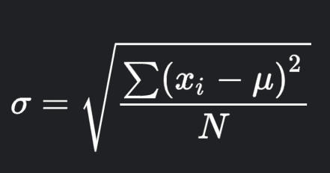

b) By Spread
Range (Difference between the largest and smallest value)
e.g. For numbers: 1, 2, 3, 4, 5, 5,6,5:
Range = 6-1 = 5
Standard deviation (SD): Index of variability
How the mean deviates for a normal distribution
Observation | Deviation from the mean | Deviation squared
1 | 1-3.5 = -2.5 | 6.25
2 | 2-3.5 = -1.5 | 2.25
3 | 3-3.5 = -0.5 | 0.25
4 | 4-3.5 = 0.5 | 0.25
5 | 5-3.5 = 1.5 | 2.25
6 | 6-3.5 = 2.5 | 6.25
Mean = 3.5 |  | Total = 17.5
Variance = (Total squared deviations/Total observations)
= 17.5/6
=2.92
SD = $\sqrt{Variance}$
= 1.71

Slide 5
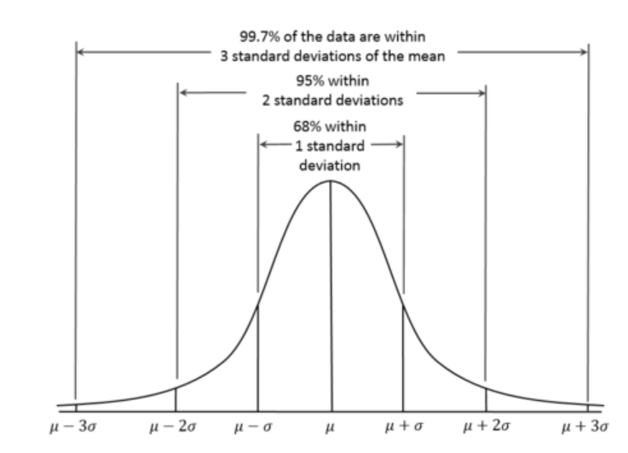

Slide 6
II. Categorical variable
e.g. Sex (M, F), Education levels (primary, sec, tertiary)
Frequencies (Number) e.g. 10 boys and 15 girls
Proportions (percentages) e.g. 30% boys and 70% girls

Slide 7
2. Bivariate Analysis
Bivariate analysis is the analysis of exactly two variables.
One dependent variable (outcome) Vs One Independent variable
Or: One variable vs Another variable
- Cont Vs Cont , Cont Vs Categorical, Categorical Vs Categorical
Can be an association e.g. Smoking Vs Lung cancer
 |  | SMOKING STATUS
CANCER STATUS |  | YES | NO
 | YES | 70 | 15
 | NO | 30 | 100

Slide 8
3. Multivariate Analysis
An outcome versus Many factors (Usually we use statistical modeling like Regression analysis)
E.g.
CANCER STATUS |  | SMOKING |  | EDUCATION LEVEL |  |  | SEX |  | AGE
 |  | YES | NO | 1-Pri | 2-Sec | 3-Tertiary | Female | Male
 | YES |  |  |  |  |  |  |  | 45
 | NO |  |  |  |  |  |  |  | 70

Slide 9
 |  | OUTCOME VARIABLE (DEPENDENT VARIABLE)
 |  | Binary | Categorical (> 2 categories) | Ordinal | Discrete | Non-Nomonal | Nominal
INPUT VARIABLE (INDEPENDENT VARIABLE) | Binary | Chi-square Fisher’s | Chi-square | Chi-square Mann Whitney | Mann Whitney | Mann Whitney Log-rank | Student’s t test
 | Categorical (> 2 categories) | Chi-square | Chi-square | Kruskal -Wallis |  | Kruskal -Wallis | ANOVA
 | Ordinal | Chi-square Mann Whitney |  | Spearman rank |  | Spearman rank | Spearman rank Linear regression
 | Discrete | Logistic regression |  |  |  | Spearman rank | Spearman rank Linear regression
 | Non-Nominal | Logistic regression |  |  |  | Spearman rank | Spearman rank Linear regression
 | Nominal | Logistic regression |  |  |  | Linear regression | Pearson and Linear regression

Slide 10
Summary
Univariate analysis (summarizing one variable)
Bivariate analysis (Two variables)
Multivariate analysis (More than 2 Variables)
Outcome and No. of independent variables (Type and Levels)& Study design determine the analysis method or statistical test to be used.
Continuous outcome = Linear Regression
Binary outcome = Logistic regression
Count outcome = Poison /Negative binomial regression
Time to event = Survival (Cox regression analysis)

