Slide 1

Introduction to Implementation Science Frameworks: Focus on CFIR YouTube: https://www.youtube.com/watch?v=nNBTHV-_zDI&t=10s
Presenter: Dr. Bashir Ssuna

Slide 2
What Are Theories?
Definition: Theories are generalized principles or ideas that explain phenomena and predict outcomes.
Role in Implementation Science: In implementation science, theories guide researchers in developing, implementing, and testing interventions.

Slide 3
What Are Frameworks?
Definition: Frameworks are structured collections of concepts or constructs that provide organized ways of studying or implementing interventions.
Role in Implementation Science: Frameworks provide practical guidance to implement interventions by organizing and evaluating factors.

Slide 4
Theories vs. Frameworks
Theories:
Provide broad, predictive, and explanatory guidance.
Focus on understanding relationships between key elements of an intervention.
Frameworks:
Offer practical guidance for applying theories to real world settings.
Contexts-specific and focused on the operationalization of theories.

Slide 5
Theoretical framework vs Conceptual framework
Theoretical frameworks: Set of concepts, definitions, propositions that come together to form a structured view of a phenomenon.
Usually presented earlier in literature review
Conceptual framework: Visual representation of the expected relationships and connections between various constructs or variables

Slide 6

Importance of Frameworks in Implementation Science
Organize
Organize Knowledge: Frameworks allow for the organization of knowledge and provide a common language for discussing implementation.
Provide
Provide Structure: Frameworks give structured guidance for planning and evaluating interventions, helping to systematically address implementation challenges.
Assess
Assess Effectiveness: They offer a framework to assess how well interventions are implemented and sustained across diverse settings.

Slide 7

Types of Implementation Science Frameworks
1. Process Frameworks: These frameworks guide the steps needed to implement an intervention. Example: Knowledge to Action Framework.
2. Determinant Frameworks: These identify factors that affect implementation, such as CFIR (Consolidated Framework for Implementation Research).
3. Evaluation Frameworks: These frameworks focus on assessing outcomes related to implementation, such as REAIM.

Slide 8
When to Use Process Frameworks
Application: Process frameworks are useful when planning and executing an intervention. They offer a step-by-step guide for ensuring successful implementation.
Examples:
Knowledge to Action (KTA) Framework.
Getting to Outcomes (GTO) Framework.

Slide 9
Introduction to CFIR
What is CFIR?: The Consolidated Framework for Implementation Research (CFIR) is a determinant framework used to identify barriers and facilitators of successful implementation across five domains.
Purpose: CFIR provides structured guidance for understanding how various contextual factors affect the implementation of interventions.

Slide 10

Why Use CFIR?
Structured Guidance: CFIR allows for the systematic identification of factors that influence the implementation process.
1
Applicable Across Contexts: CFIR has been applied in various fields, including healthcare, public health, and education, providing flexible guidance in diverse settings.
2
Comprehensive Evaluation: The framework covers a wide range of factors, from individual characteristics to organizational dynamics.
3

Slide 11
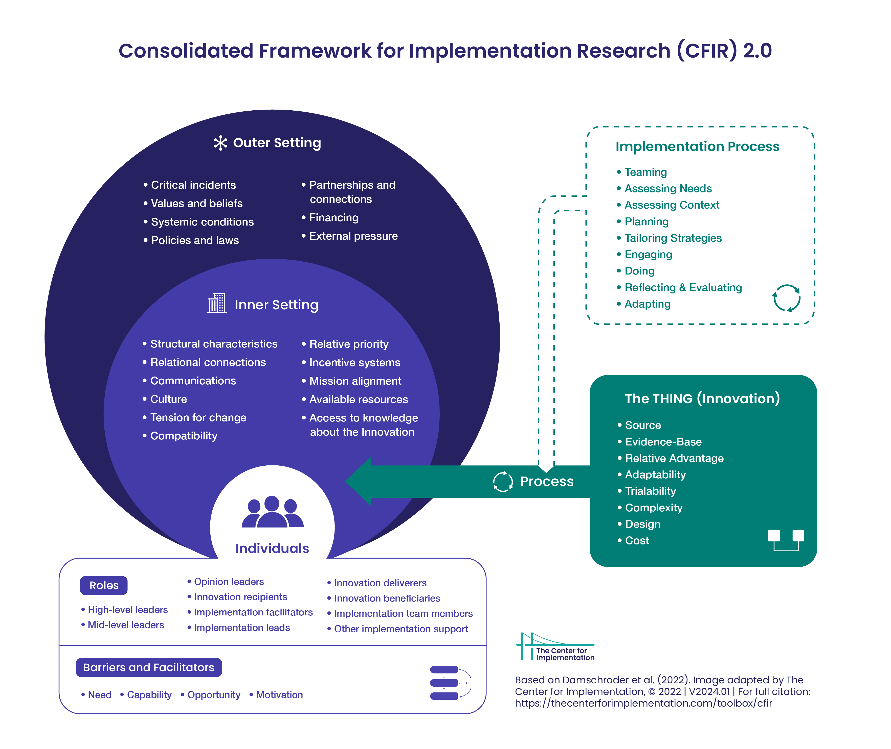
Overview of CFIR Domains
CFIR has five domains:
1. Intervention Characteristics
2. Outer Setting
3. Inner Setting
4. Characteristics of Individuals
5. Process

Slide 12
CFIR Domain 1: Intervention Characteristics
Definition: This domain refers to the attributes of the intervention itself, including:
Adaptability: How flexible the intervention is to different settings.
Complexity: How difficult or easy it is to implement.
Cost: Financial requirements for implementation.

Slide 13

CFIR Domain 2: Outer Setting
Definition: The outer setting includes external factors that influence implementation, such as:
Patient Needs: The extent to which an intervention addresses patient demands.
External Policies: Policies, regulations, and incentives affecting implementation.

Slide 14

CFIR Domain 3: Inner Setting
Definition: The inner setting refers to the organizational characteristics that affect implementation, including:
Culture: Organizational norms, values, and routines.
Leadership Engagement: The commitment and involvement of leaders to drive implementation.
Available Resources: Availability of adequate resources such as staff, training, and financial support.

Slide 15

CFIR Domain 4: Characteristics of Individuals
Definition: This domain focuses on the individuals involved in the implementation process, including:
Knowledge and Beliefs: Individual understanding and perception of the intervention.
Self-Efficacy: Confidence in their ability to implement the intervention.

Slide 16
CFIR Domain 5: Process
Definition: The process domain focuses on the key steps taken to implement and sustain an intervention. It includes:
Planning: Developing strategies and plans for implementation.
Engagement: Ensuring stakeholders are involved in the implementation process.
Evaluation: Monitoring and assessing the outcomes of the intervention.

Slide 17

Application of CFIR in Healthcare

Slide 18
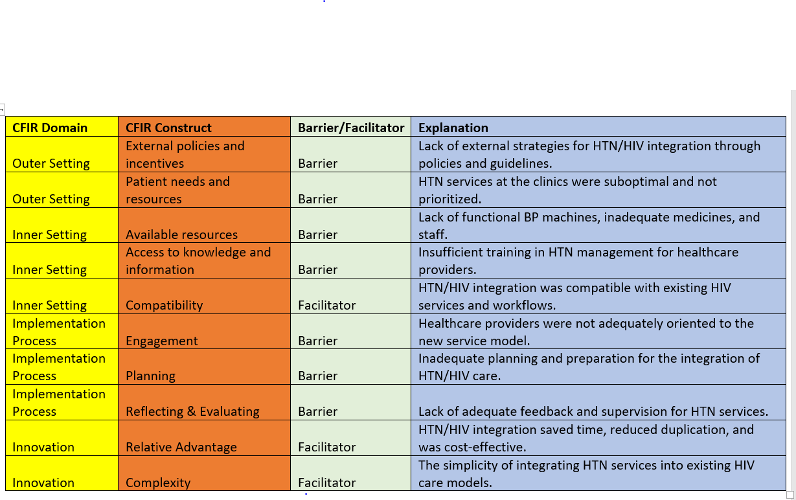

Slide 19
Benefits of Using CFIR
Systematic Identification: CFIR helps systematically identify key factors that influence implementation.
Adaptability: CFIR can be tailored to fit various fields such as public health, healthcare, and education.
Comprehensive Approach: CFIR allows for a comprehensive evaluation of an intervention by addressing different levels of influence.

Slide 20
Steps for Implementing CFIR
Step 1: Identify relevant constructs from the five CFIR domains.
1
Step 2: Collect data from multiple sources (interviews, surveys) using CFIR constructs as a guide.
2
Step 3: Analyze data to identify key barriers and facilitators for implementation.
3

Slide 21
Using CFIR for Qualitative Data Collection
Interviews and Focus Groups: CFIR constructs can be used to develop interview guides and focus group questions to gather qualitative data on barriers and facilitators.
Data Coding: Interview data is typically coded according to CFIR constructs, which allows for systematic analysis.

Slide 22
Tailoring Interventions Using CFIR
Contextual Adaptation: CFIR allows interventions to be adapted based on the unique contextual factors of the setting. For example, an intervention in a rural clinic may require different resources than one in an urban hospital.
CFIR’s Role in Strategy Development
Strategy Design: CFIR helps in the design of strategies to overcome barriers and leverage facilitators. For example, engaging leadership may help to overcome cultural resistance to change.

Slide 23

Challenges in Using CFIR
Complexity: CFIR involves many constructs and domains, which can be difficult to manage in largescale interventions
Overreliance on Qualitative Data: In some cases, CFIR studies rely heavily on qualitative data, making it difficult to generalize findings.

Slide 24
Enhancing CFIR with Other Frameworks
Hybrid Frameworks: CFIR can be combined with other frameworks, such as REAIM, to provide a more comprehensive evaluation of implementation outcomes.
Example: A study combining CFIR and REAIM to assess both the factors influencing implementation and the public health impact of the intervention.

Slide 25
CFIR in Large-Scale Interventions
CFIR has been applied to large-scale interventions like cancer screening programs, focusing on leadership and resource availability.

Slide 26
Customizing CFIR for Your Study
Tailoring Constructs: While CFIR offers a comprehensive list of constructs, researchers can select only the most relevant ones for their specific study.
Steps:
1. Identify Key Domains: Select domains most relevant to your intervention, such as intervention characteristics and inner setting.
2. Focus on Context: Tailor the framework to address the specific context of the intervention, such as rural vs. urban healthcare settings.

Slide 27
CFIR Construct Selection Based on Study Objectives
Construct Relevance: The selection of CFIR constructs depends on the specific objectives of your study. For example, if the focus is on intervention adoption, constructs related to "characteristics of individuals" and "inner setting" would be most relevant.
Guidelines for Selection:
Align constructs with research questions.
Select constructs based on the phase of implementation (e.g., planning, execution).

Slide 28

END
Questions and Discussion

